Slide 1
Computational methods for predicting the pK_{a} of terminal alkynes
Antonio Ljulj,ª Lea Malezan,ª Maria Kolympadi Marković,^{b} Dean Marković,^{b} Davor Šakić,ª and Valerije Vrčekª
ª University of Zagreb Faculty of Pharmacy and Biochemistry, Ante Kovačića 1, Zagreb, Croatia
^{b} Department of Biotechnology, University of Rijeka, Radmile Matejčić 2, Rijeka, Croatia
Acknowledgement: This research was funded by the Croatian Science Foundation through the project, IP-2022-10-2634 PHARMA-ECO and UIP-2020-02-4857 LIGHT-N-RING

Slide 2
pKa of terminal alkynes
pKa ≈ 25
Impacts other physicochemical properties
Acetylide anions (RC≡C⁻) are strong nucleophiles and bases, important in C–C bond-forming reactions
Impacts deuterium and tritium labelling

Slide 3
Investigated techniques
Standard thermodynamic cycles
Isodesmic reactions
IR vibrational modes
Atomic charges
NMR chemical shifts
Kinetic approach (hydrogen exchange)

Slide 4
Investigated molecules

Slide 5
Computational details
Optimization: B3LYP/6-31+G(d,p) M06L/6-31+G(d,p)
Single point calculations: B3LYP/6-311+G(2df,p) M06L/6-311++G(d,p)
All calculations were done using the Gaussian 16 software package installed on the Isabella cluster based in SRCE –University of Zagreb University Computing Centre.

Slide 6
Thermodynamic cycles
Problem – inaccurate solvation energies of H₂O and H₃O⁺
We used experimental values
ΔG_{rxn,gas} = G_{gas}(RCC⁻) + G_{gas}(H₃O⁺) - G_{gas}(RCCH) – G_{gas}(H₂O)
ΔG_{rxn,sol} = ΔG_{rxn,gas} + ΔG_{sol}(RCC⁻) + ΔG_{sol}(H₃O⁺) - ΔG_{sol}(RCCH) - ΔG_{sol}(H₂O)
pK_{a} = ΔG_{rxn,sol}/2.303RT – log [H₂O]

Slide 7
The correlation (solid line) between calculated (B3LYP/6-31+G(d,p) level) and experimental aqueous acidities of terminal alkynes.

Slide 8
Isodesmic reactions
pK_{a} (R-C≡CH) = (ΔG_{rxn,sol} / 2.303 RT) + pK_{a} (HC≡CH)
ΔG_{rxn,sol} = G_{sol}(R-C≡C⁻) + G_{sol}(HC≡CH) - G_{sol}(R-C≡CH) - G_{sol}(HC≡C⁻)
Slightly improved accuracy due to the use of ethyne as reference

Slide 9
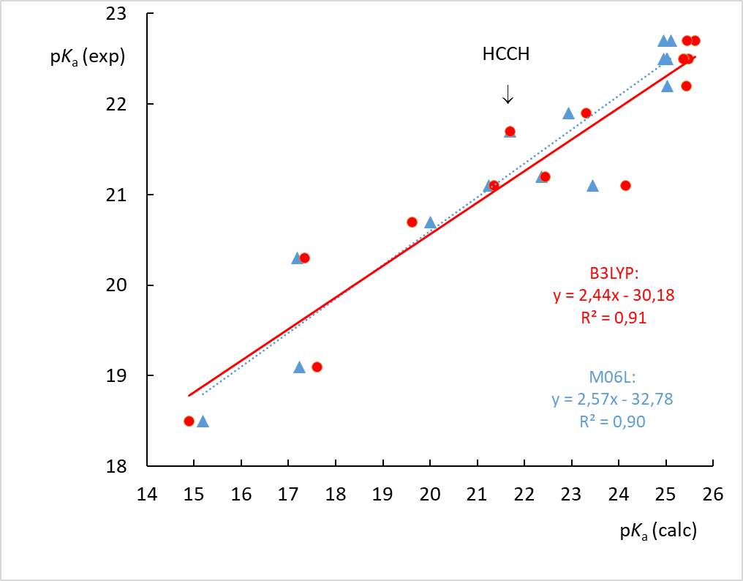
Experimental acidities vs. theoretical pK_{a} values for terminal alkynes calculated from the isodesmic reaction in which acetylene (HCCH, pK_{a} = 21.7) was used as a reference.

Slide 10
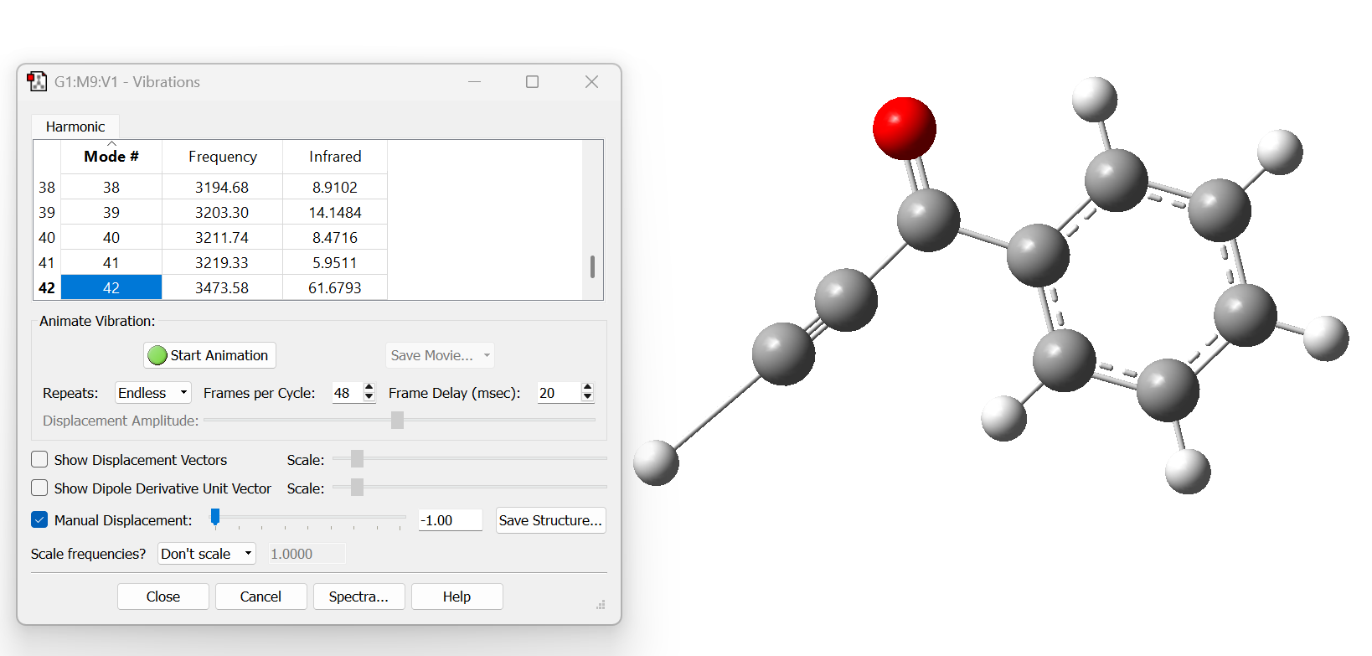
IR vibrational modes and atomic charges
Simple, easily computed
No correlation

Slide 11
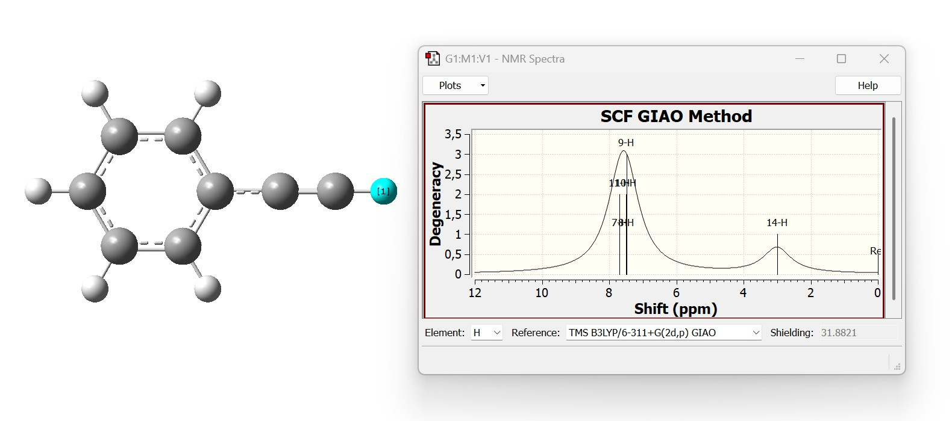
NMR chemical shifts
Calculated GIAO chemical shifts
Relationship between experimental pK_{a} values of acetylenes and ¹H NMR chemical shifts (d_{calc}) of the terminal alkyne hydrogen calculated at the GIAO-M06L/6-311++G(d,p)//M06L/6-31+G(d,p) level of theory. Phenylacetylenes (open circles) appear as outliers

Slide 12
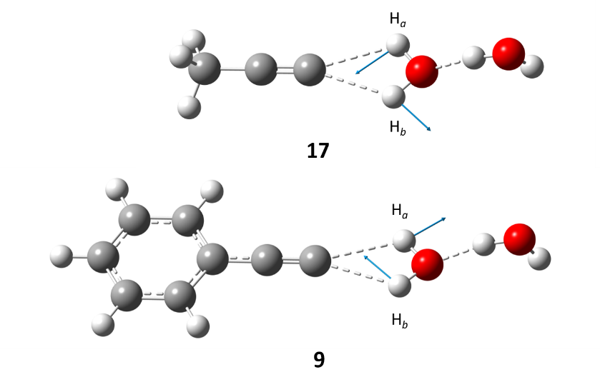
Kinetic approach
Proposed by Kresge et al., 1991.
TS of base catalyzed hydrogen exchange (identical motif)

Slide 13
Relationship between experimental pK_{a} values and free energy barriers (DG‡) for hydrogen exchange in terminal alkynes calculated at the M06L/6-31+G(d,p) level.

Slide 14
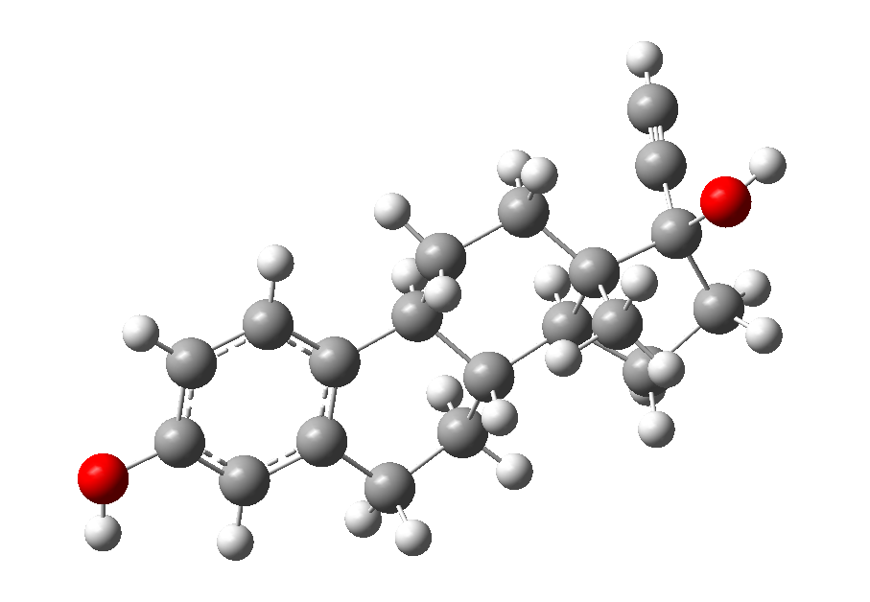
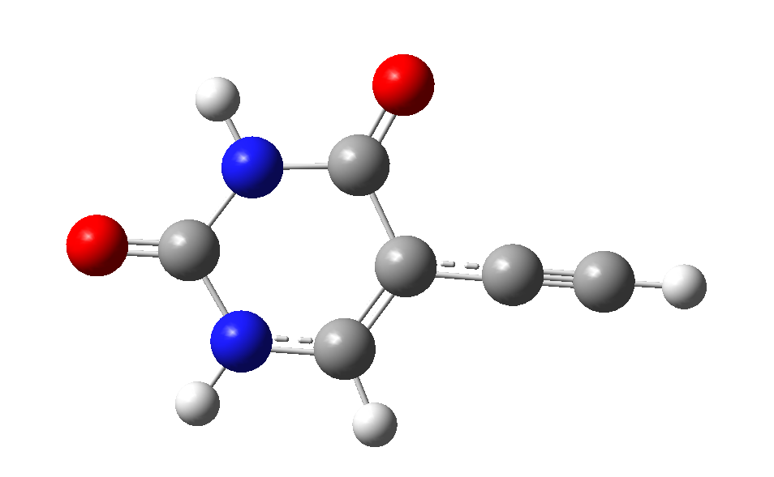
Pharmaceutical alkynes
Comparison of H-D exchange with NMR shift and kinetic barrier

Slide 15
Thank you for your attention!

