Slide 1
Quantum Mechanics/Molecular Mechanics: Powerful Tool for Investigating Noble Metal Liganded Nanoclusters for Bio-Applications
Department of Chemistry
Faculty of Science
University of Zagreb
www.compchemday.org
Martina Perić Bakulić^{a,b}
ª Faculty of Chemistry and Technology, University of Split, Ruđera Boškovića 35, 21000 Split, Croatia
^{b} Center of Excellence for Science and Technology-Integration of Mediterranean Region (STIM)
at Interdisciplinary Center for Advanced Sciences and Technology (ICAST),
University of Split, Poljička cesta 35, 21000 Split, Croatia

Slide 2
Quantum Mechanics/Molecular Mechanics:
Powerful Tool for Investigating
Noble Metal Liganded Nanoclusters for Bio-Applications
www.compchemday.org
When it's appropriate to use
Quantum Mechanics/Molecular Mechanics (QMMM)?
When investigating electronic (subatomic) molecular properties of complex molecular systems (examples: DNA, protein, ...)
Goal of QMMM method is to combine ACCURACY of Quantum Mechanics with the SPEED of Molecular Mechanics (MM) method
Quantum Mechanics methods: ab initio (Hartree-Fock), semiempirical approach (MNDO, AM1, PM7...) and Density Functional Theory
Molecular Mechanics (Force Fields: Amber, CHARMM, Gromos, OPLS, UFF...)
ONIOM METHOD? Widely used QMMM approach implemented in Gaussian computational chemistry software.

Slide 3
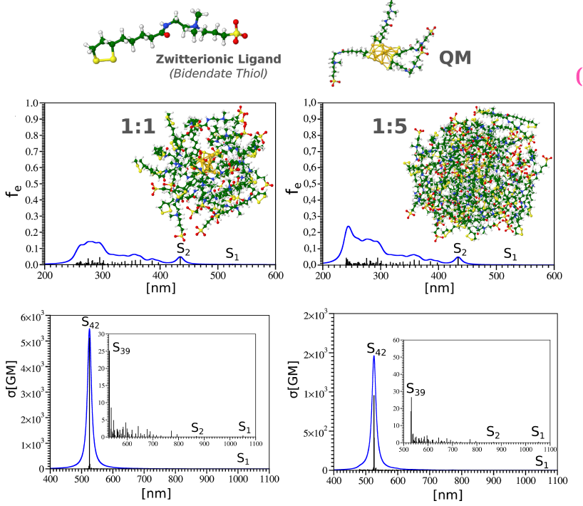
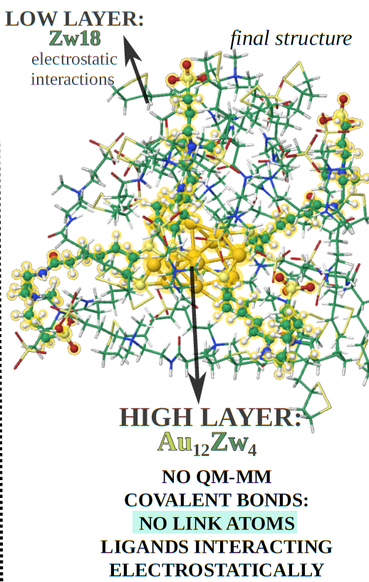
Quantum Mechanics/Molecular Mechanics:
Powerful Tool for Investigating
Noble Metal Liganded Nanoclusters for Bio-Applications
www.compchemday.org
QMMM method approach examples:
In this paper the ONIOM method (QMMM) was successfully used on Zwitterion liganded gold nanocluster in electrostatic environment of the "pull" of zwitterionic ligands.
Structural and optical properties (OPA and TPA) were predicted and confirmed by experiments.
Ligand shell size effects on one- and two-photon excitation fluorescence of zwitterion functionalized gold nanoclusters, Perić M. et al. Phys. Chem. Chem. Phys., 2019,21, 23916-23921

Slide 4
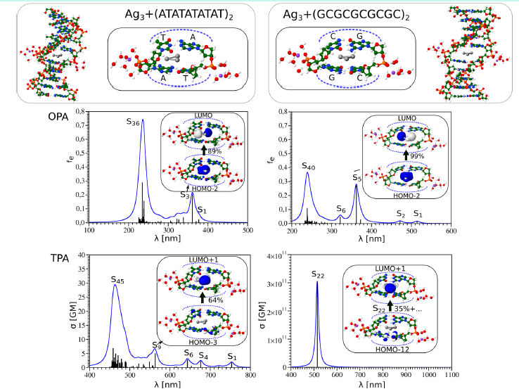
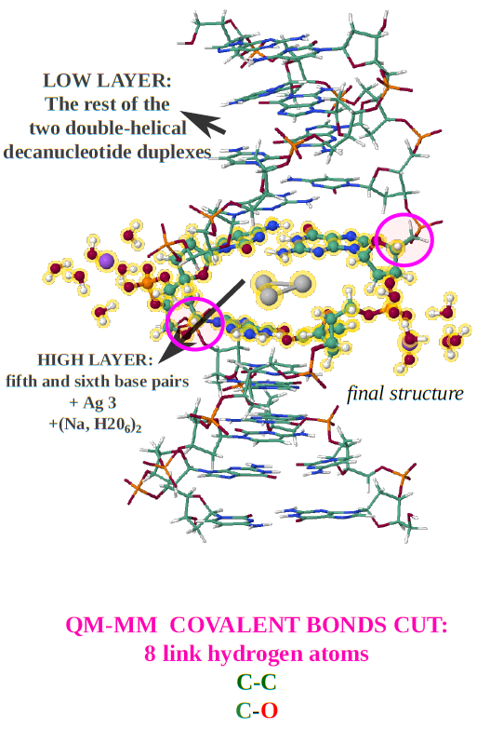
Quantum Mechanics/Molecular Mechanics:
Powerful Tool for Investigating
Noble Metal Liganded Nanoclusters for Bio-Applications
www.compchemday.org
In this paper the ONIOM method (QMMM) was employed for investigating small silver trimer (Ag3) intercalated in two types of DNA moleculed (CG and AT rich)
Structural and optical properties (OPA and TPA) were predicted and showed that CG rich DNA molecules together with intercalated silver trimer have rich potential in bioimaging applications!
Why Do Silver TrimersWhy Do Silver Trimers Intercalated in DNA
Exhibit Unique Nonlinear Properties That Are Promising for Applications?
V. Bonačić-Koutecký et al.
J. Phys. Chem. Lett. 2018 9 (10), 2584-2589

