Slide 1
Full Conformational Analysis of Cashmeran by Principal Component Analysis of Molecular Dynamics Trajectory
Department of Chemistry
Faculty of Science
University of Zagreb
www.compchemday.org
Jakov Borovec,ª Marina Poljak,^{b} Karlo Sović,ª Ines Primožičª and Tomica Hrenarª
ªDepartment of Chemistry, Faculty of Science, University of Zagreb,
Horvatovac 102a, 10000 Zagreb, Croatia
^{b}SAPONIA D.D., M. Gupca 2, 31000 Osijek, Croatia

Slide 2
Full Conformational Analysis of Cashmeran by Principal Component Analysis of Molecular Dynamics Trajectory
www.compchemday.org
§ Introduction
Cashmeran is a fragrant, musky compound discovered at International Flavors & Fragrances company, commonly found in perfumes.
Potential energy surface was sampled by ab initio molecular dynamics and dimensionality reduction was conducted using PCA.
Probability density function in the reduced space was built and all strict local maxima were found.
Initial guess structures were optimized at B3LYP-D3/6-31G(d) level of theory, clustered and then additionally optimized at B3LYP-D3/6-311++G(d,p) level.

Slide 3
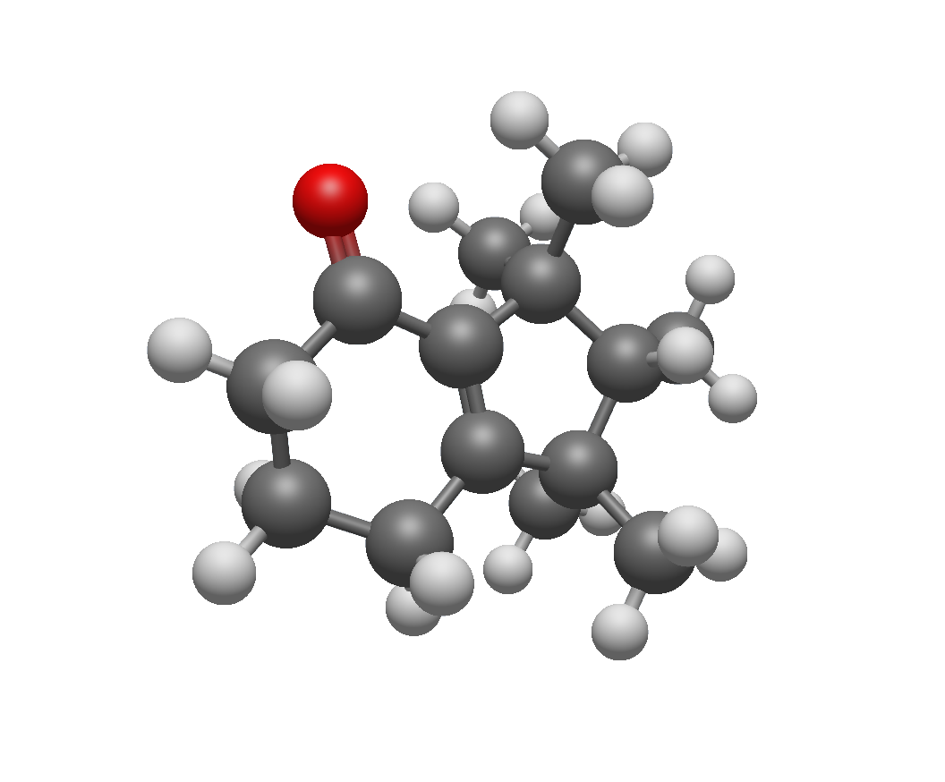
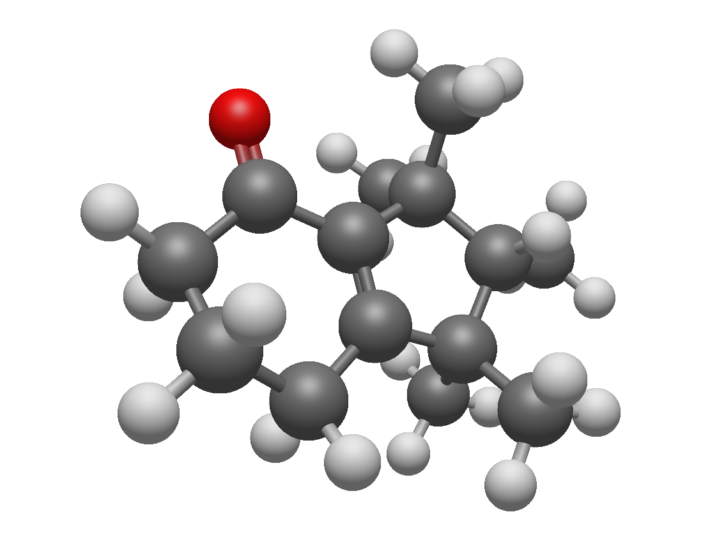
Full Conformational Analysis of Cashmeran by Principal Component Analysis of Molecular Dynamics Trajectory
www.compchemday.org
§ Results
After optimization and clustering, five conformers were obtained with the two most prevalent conformers shown below (>99% according to the Boltzmann distribution).
$$∆_{f}G_{rel}^{o}=0.00 kJ {mol}^{−1}$$
$$∆_{f}G_{rel}^{o}=0.73 kJ {mol}^{−1}$$

Slide 4
Full Conformational Analysis of Cashmeran by Principal Component Analysis of Molecular Dynamics Trajectory
www.compchemday.org
§ Conclusion
A full conformational analysis of cashmeran by tensor decomposition of ab initio molecular dynamics trajectory was carried out.
Probability density function in the 10-dimensional reduced space (75% of the total variance) was built and a search for initial guess structures was carried out.
In total five conformers were obtained with two dominating in content and covering more than 99% of content.

