Slide 1
Project HR-ZOO - The Final Stages of Implementation
Dobriša Dobrenić, Emir Imamagić, Ivan Marić
University of Zagreb, University Computing Centre

Slide 2









Croatian Scientific and Educational Cloud (HR-ZOO)
Strategic project by Ministry of Science and Education of Republic of Croatia
Coordinator: SRCE
Reference No: KK.01.1.1.08.0001
Project value: 196.802.438,11 HRK
EU contribution: 167.282.072,40 HRK
National share: 29.520.365,71‬ HRK
Implementation: 1.7.2017. - 30.4.2023.
Distributed national e-infrastructure of computing, storage and network resources for different purposes, designed for strengthening the capacity of the Croatian academic and research community
for research, technological development and innovation.

Slide 3


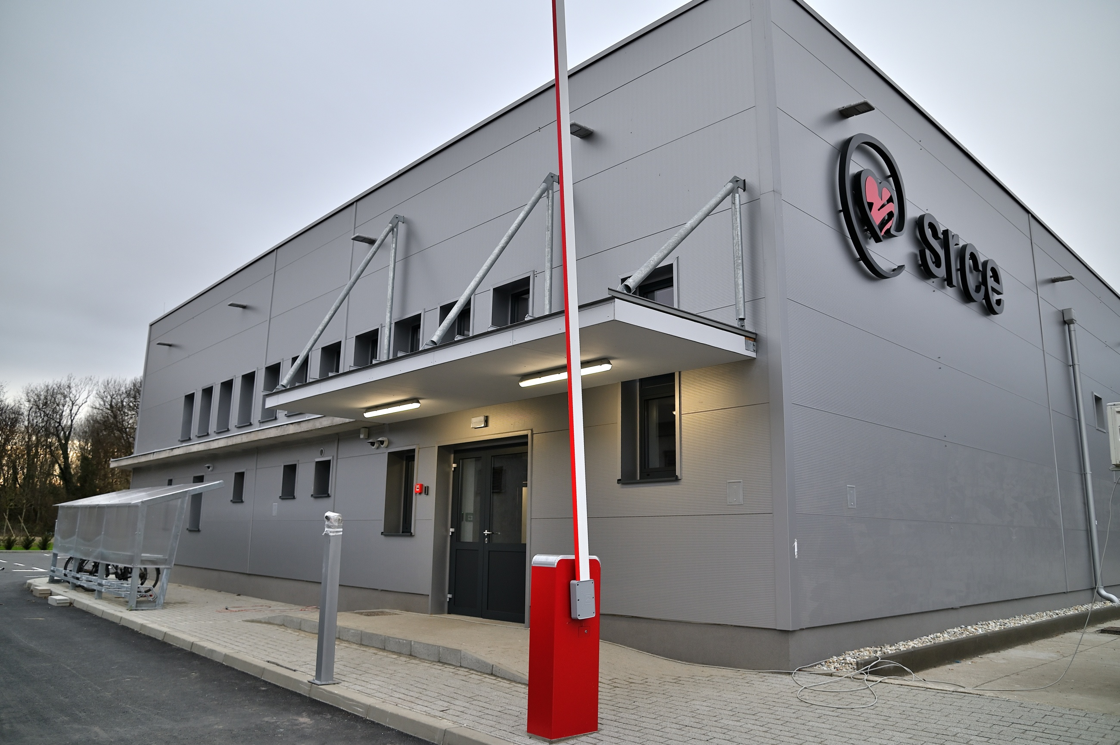

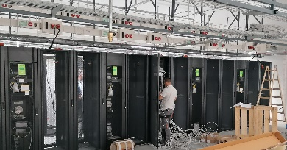
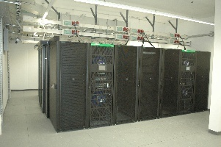
Data centres
HR-ZOO
ZG2
HR-ZOO
ZG1
5 data centres connected by high speed broadband network ...
HR-ZOO
OS
HR-ZOO
RI
HR-ZOO
ST
DC network infrastructure
100/25/10/1 Gbit/s

Slide 4


Service Catalogue
Virtual Data
Centers
High Performance Computing
Elastic Cloud Computing
Storage
Scientific Software
Specialized support to researchers
Collocation of ICT equipment

Slide 5
High Performance Computing
HPE Cray solution
1.156 TFLOPS R_{max}, 1.908 TFLOPS R_{peak}
HPE ClusterStor E1000
  500 TB on NVMe SSDs
  100 GByte/s, 1 MIOPS random access
Slingshot interconnect
  200 Gbit/s, 2 x 200 Gbit/s for GPU nodes

Slide 6
High Performance Computing
CPU nodes
52 nodes
6.656 CPU cores
260 TFLOPS
Node:
2 CPUs AMD Epyc 7763 2,45 GHz
128 CPU cores
256 GB RAM
GPU nodes
21 nodes
84 GPUs
1.344 CPU cores
1638 TFLOPS
Node
4 GPUs NVIDIA A100
1 CPU AMD Epyc 7763 2,45 GHz
64 CPU cores
512 GB RAM
Big memory nodes
2 nodes
256 CPU cores
10 TFLOPS
Node
2 CPUs AMD Epyc 7763 2,45 GHz
128 CPU cores
4 TB RAM
Login nodes
CPU node
2 CPUs AMD Epyc 7763 2,45 GHz
128 CPU cores
256 GB RAM
GPU node
1 CPUs AMD Epyc 7763 2,45 GHz
1 GPU NVIDIA A100
64 CPU cores
128 GB RAM

Slide 7
High Performance Computing
PBSPro batching system
HPE Cray Programming Environment
  Compilers, MPIs, OpenMP, Debugging, Performance Analysis & Optimization
Environment management
  Modules, Spack, EasyBuild
Tuning, application deployment & benchmarking start planned for December 2022
  new CPU architecture, storage, interconnect, batching system & compiler stack
  ~90 scientific applications, 24 computational chemistry area

Slide 8
Elastic Cloud Computing
HPE servers
11.000 CPU cores & 16 GPUs
Storage
  1 PB standard storage (HDD)
  200 TB fast storage (NVMe SSD)
Ethernet interconnect
  2 x 25 Gbit/s, 4 x 100 Gbit/s for fast storage

Slide 9
Elastic Cloud Computing
CPU nodes
86 nodes
11.008 CPU cores
Node:
2 CPUs AMD Epyc 7713 2,0 GHz
128 CPU cores
512 GB RAM
GPU nodes
4 nodes
16 GPUs
256 CPU cores
Node
4 GPUs NVIDIA A100
1 CPU AMD Epyc 7713 2,0 GHz
64 CPU cores
512 GB RAM
Big memory nodes
2 nodes
256 CPU cores
Node
2 CPUs AMD Epyc 7713 2,0 GHz
128 CPU cores
2 TB RAM

Slide 10
Elastic Cloud Computing
OpenStack cloud
Applications
  On demand clusters (EC3) for education & training
  Jupyter notebooks
  BigData platforms
  Interactive workloads
Tuning, application deployment & benchmarking start planned for October 2022

Slide 11
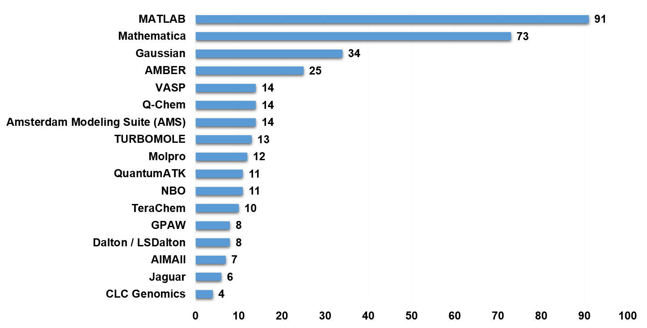
Scientific Software
Survey in February 2022
  400 participants from 50 institutes
Market analysis
Public tender
  started in August 2022
  still in progress
  6 software packages
  5 from the computational chemistry field

Slide 12
Final Steps
Tuning, application deployment & benchmarking
Access & report interfaces
Terms of use
Documentation & training
Expected before the end of project – April 30th 2023

Slide 13




What after the project?
Support,
Colaboration,
Integration…
Replacement of the
e-infrastructure components:
High performance data analytics (HPDA)
Artificial Intelligence (AI)
Machine Learning
Internet of Things (IoT)
New services
depending on the obsolescence of the individual technology
depending on the actual needs of the community
National HPC Competence Centre,
EDIH CROHUB++,
NOSC (HR-OOZ),
EOSC …

Slide 14
Project HR-ZOO - The Final Stages of Implementation
Thank You For Your Attention!

