Slide 1
Rational design, synthesis and biological profiling of new JMJD2C inhibitors
Computational Chemistry Day, 11th May 2019
Vatroslav Letfus
Mentor: izv. prof. dr. Sanja Koštrun

Slide 2
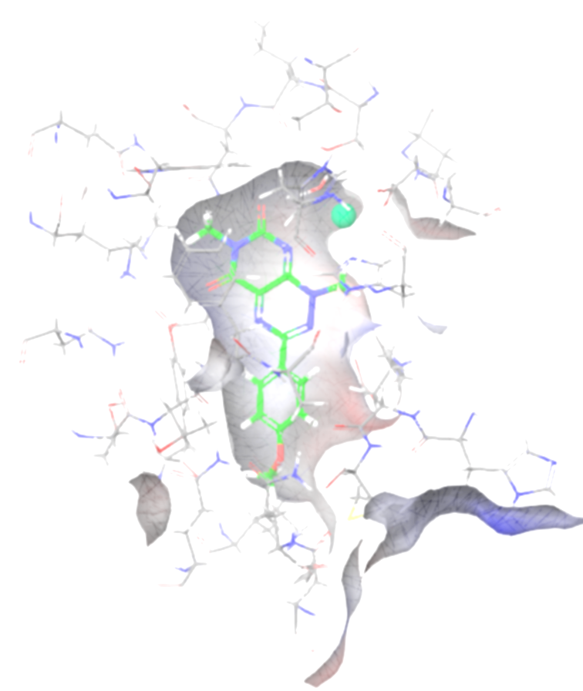
Rational design, synthesis and biological profiling of JMJD2C inhibitors
Introduction to epigentics and JMJD2C enzyme
Computer aided design and synthesis of inhibitors
Inhibition activity and ADME profiling results
Conclusions

Slide 3
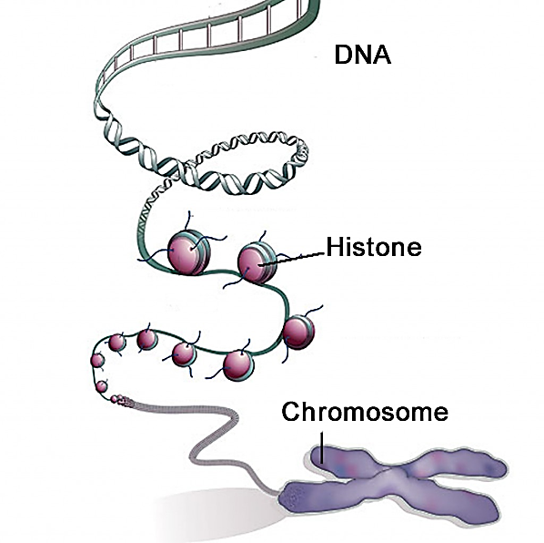
Epigenetics
Packaging the 3 billion nucleotides of the human genome into the nucleus of a cell requires tremendous compaction
DNA in our chromosomes is wrapped around spools of proteins called histones to form dense repeating protein/DNA polymers
Chromatin templates form the basis of a newly appreciated and fundamentally important set of gene control mechanisms termed epigenetic regulation
By conferring a wide range of specific chemical modifications to histones and DNA, epigenetic regulators modulate the structure, function, and accessibility of our genome, thereby exerting a tremendous impact on gene expression
Increasing number of these enzymes have been associated with a variety of disorders such as cancer

Slide 4
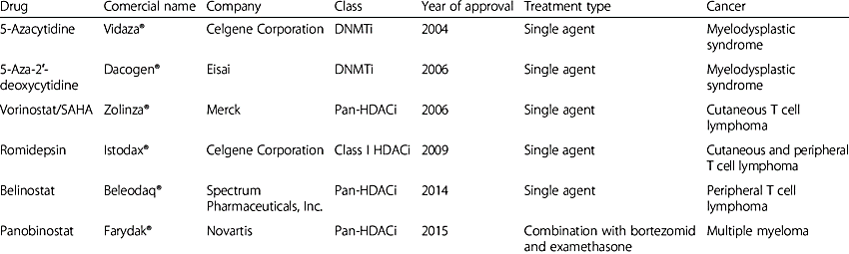
Epigenetics in cancer
Epigenetic changes are prevalent in cancer and play a causative role in its biology
DNA methylation, posttranslational modifications of histones and chromatin remodeling enzymes mediate epigenetic changes
https://www.researchgate.net/figure/Epigenetic-drugs-for-cancer-therapy-approved-by-FDA_tbl1_308186760

Slide 5
JMJD2C (GASC1, KDM4C) histone demethylase
JMJD2C enzyme was discovered in 2006
A member of JMJD2 family (Jumonji protein-containing domain) of histone demethylases
Nuclear protein that demethylates lysine 9 on histone H3 (H3K9me3/me2)
Requires Fe(II) and α-ketoglutarate as cofactors
Plays a significant role in the epigenetic regulation of gene expression by applying transcription factors to the chromatin
Amplified in a range of cancers (prostate, oesophageal, lung, breast and desmoplastic medulloblastoma)

Slide 6
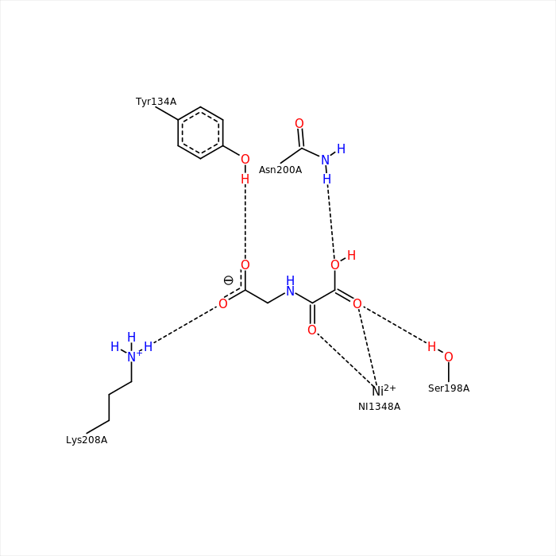
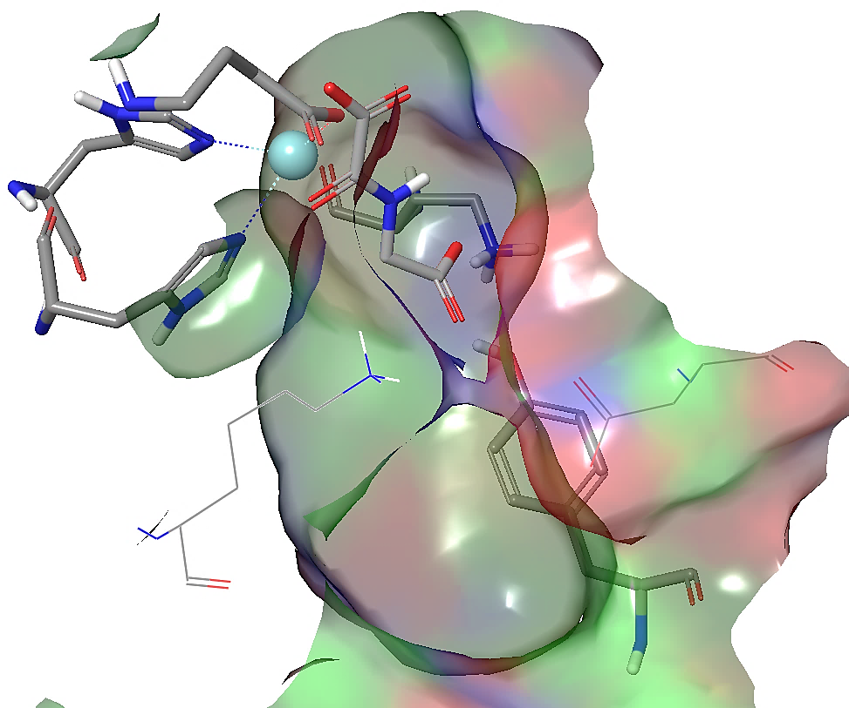
JMJD2C binding site key features
α-ketoglutarate
Metal binding
site
Lys
Ni²⁺
Hydrogen bonding and charge interactions diagram
Salt bridge at the enterance to the active site
Tyr

Slide 7

Aims and objectives
Design and synthesize new inhibitor molecules with a toxoflavin scaffold using rational design
Determine inhibitory activity using a biochemical and cell-based assays
Investigate physico-chemical properties of new molecules
Profile ADME properties

Slide 8
Study cascade
Analysis of available structural data
Design of molecules
Analysis of available biology data
In silico profiling
Synthesis
% Inhibition
@ 10 µm
ADME profiling
Cytotoxicity
IC₅₀ values

Slide 9
Known JMJD2C inhibitors
Current tool compounds are mainly molecules with carboxylic acid moiety
Low cell membrane permeability
Aim of this study:
To keep:
  Activity on JMJD2C in nanomolar range
To achieve:
  Identify scaffolds with non-acidic war-heads
  Increase cell permeability
  Metabolic stability
To examine ligand – metal coordinative binding interactions

Slide 10
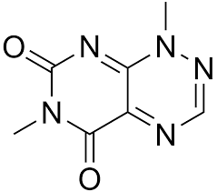
Toxoflavin scaffold
Starting point was ChemBL search of available literature data
Activity of toxoflavin: 541 nM
Small molecule - good starting point for further optimization
Non-acidic scaffold - potential to get cell permeable inhibitors
Diversification potential
Other scaffolds identified recently:
PDB: 5FJK
PDB: 5FJH
IC₅₀ ~ 1000 nM
IC₅₀ ~ 100 nM

Slide 11
Toxoflavin scaffold
Starting point was ChemBL search of available literature data
Activity of toxoflavin: 541 nM
Small molecule - good starting point for further optimization
Non-acidic scaffold - potential to get cell permeable inhibitors
Diversification potential
Toxoflavin liabilities:
Non-selective electron transferring function induces cell death
Oxidized
Reduced

Slide 12
From design to profiling
Design of focused toxoflavine library
  Ligand-receptor interactions
  In silico ADME profiling
Synthesis of focused library
Biological profiling – binding studies
In vitro ADME profiling
Biological profiling – cell-based assays

Slide 13
From design to profiling
Design of focused toxoflavine library
  Ligand-receptor interactions
  In silico ADME profiling
Synthesis of focused library
Biological profiling – binding studies
In vitro ADME profiling
Biological profiling – cell-based assays

Slide 14
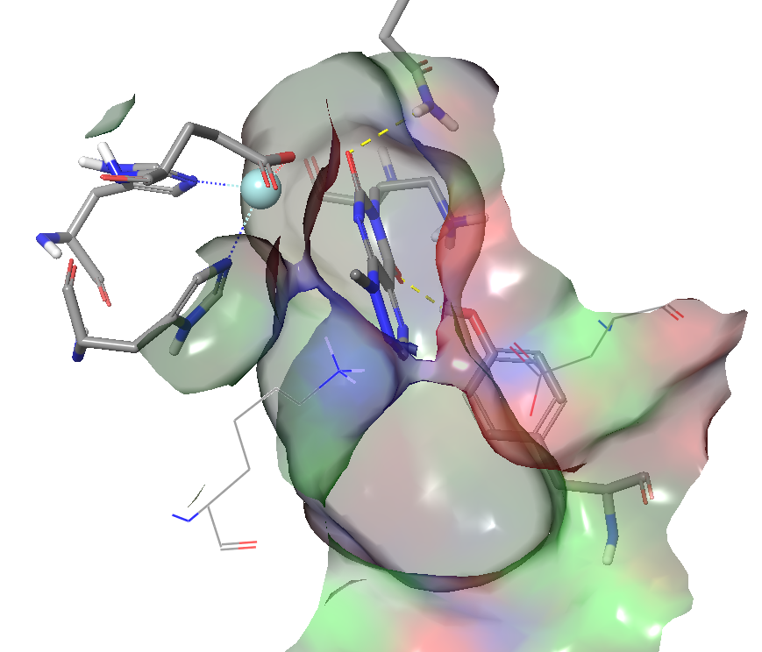
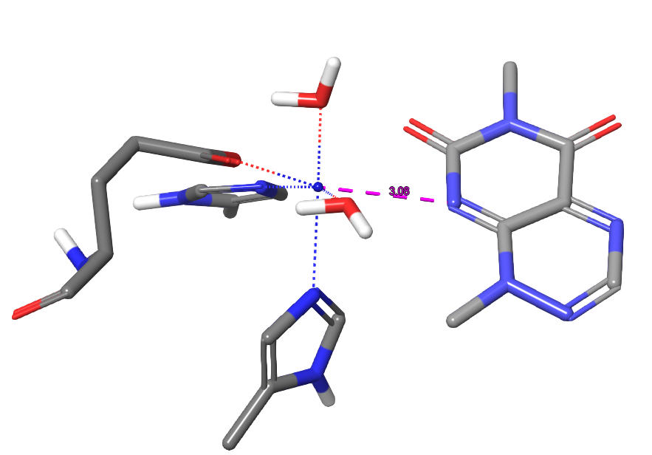
Hit expansion based on the toxoflavin scaffold
Site of diversification
Aim: to introduce phenyl substituents decorated with electron donating and withdrawing groups to optimize activity and decrease red-ox potential
Diversification vector

Slide 15
First generation of target molecules
Site of diversification

Slide 16



Computational methods
In silico profiling of physico-chemical properties
  ACD Percepta:
    Permeability
    Plasma protein binding
    CYP inhibition
    Solubility
Ligand – receptor interaction study
  Schrodinger software suite:
    Docking studies - Glide
    QM/MM methods – Qsite
  Cresset suite of software
    Field based alignment
    3D qualitative SAR models

Slide 17
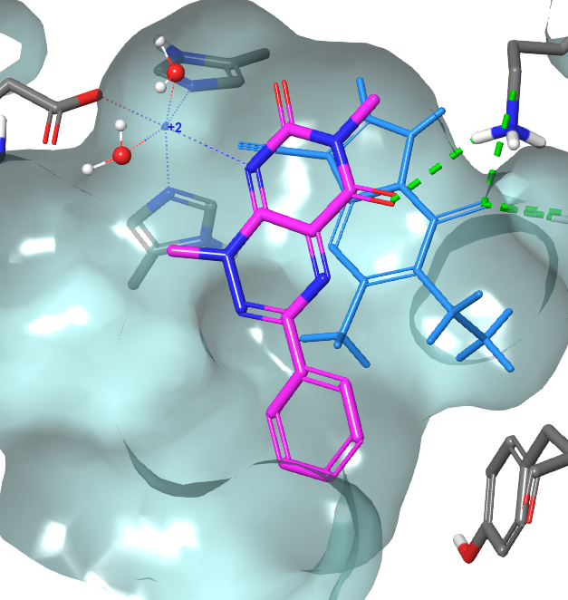
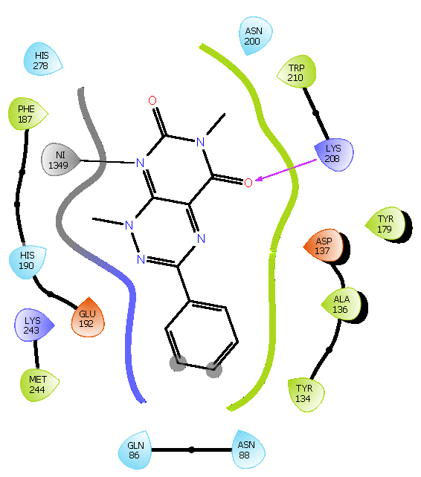
SBDD approach to design JMJD2C inhibitors
Docking study
His278
Glu192
Lys208
The ligand docking studies were carried out using Glide docking protocol within Schroedinger software suite with and without extra precision (SP, XP)
Docking was performed using metal-ligand constrains and octahedral coordination
Both monodentate and bi-dentate coordinations were explored
Binding poses were refined and binding energies estimated using MM-GBSA protocol and OPLS5 force-field with flexible residues distance being 6 Å
His190
d(Ni-N)=2.9 Å

Slide 18
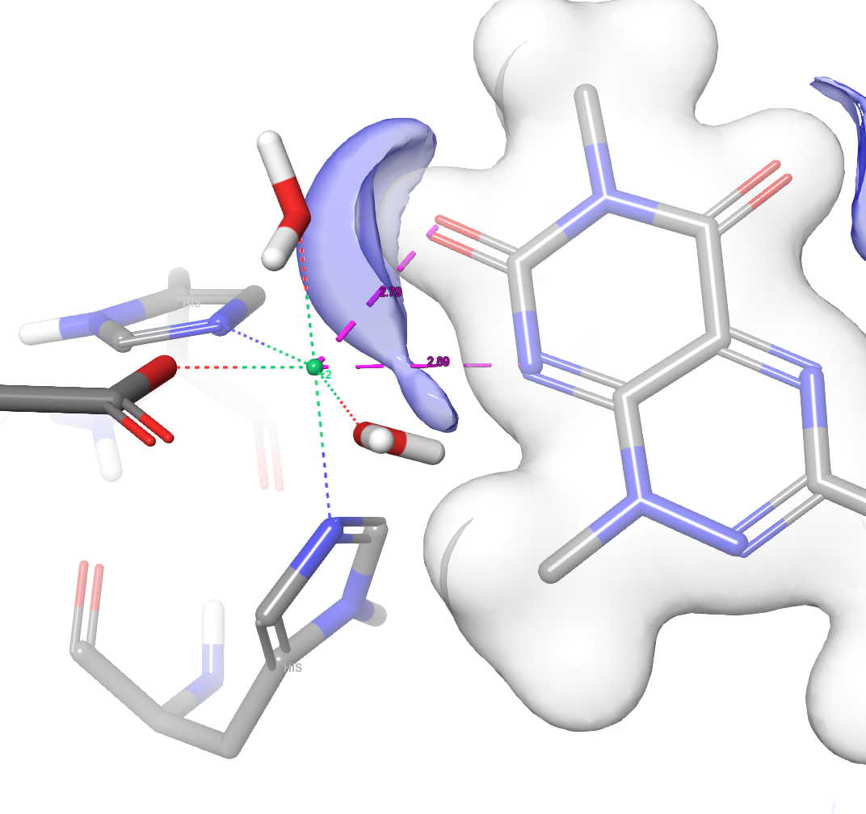
SBDD approach to design JMJD2C inhibitors
QM/MM
Quantum Mechanics/ Molecular Mechanics (QM/MM) calculations were done with QSite within the Schroedinger software
QM part was composed from the metal ion first coordination sphere including crystal water molecules, His278, triade His190, Thr191, Glu192 and the ligand molecule
QM part of the metal complex was treated with B3LYP functional and 6-31+(2d,p) basis set for H,C,O and N atoms and lav3p++(2d,p) basis set for metal ions
QM coordination sphere
6-31+(2d,p) - Pople style valence double zeta basis set with diffes functions on heavy atoms
lav3p++(2d,p) - Los Alamos Effective Core Potentials, valence triple zeta

Slide 19
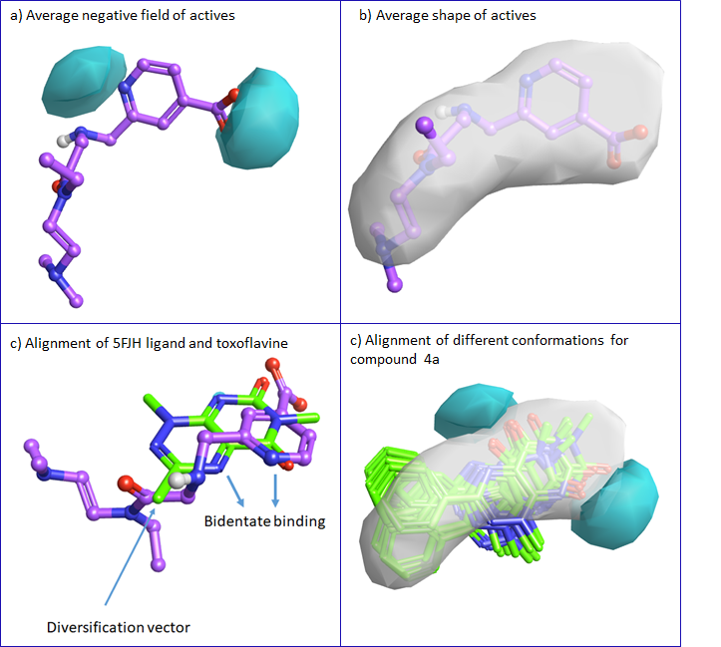
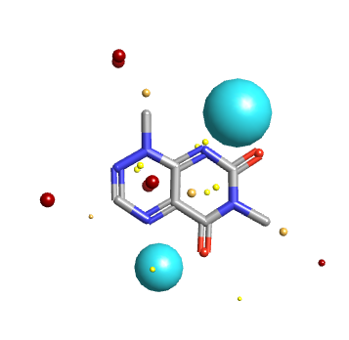
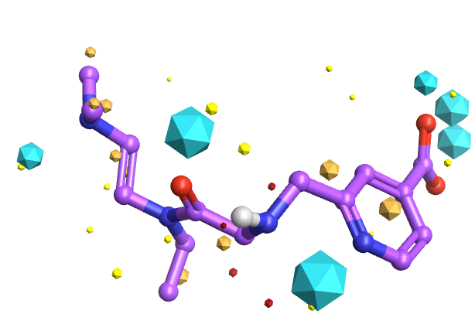
LBDD approach to design JMJD2C inhibitors
Field-based pharmacophoric features
Toxoflavine
5FJH ligand

Slide 20
From design to profiling
Design of focused toxoflavine library
  Ligand-receptor interactions
  In silico ADME profiling
Synthesis of focused library
Biological profiling – binding studies
In vitro ADME profiling
Biological profiling – cell-based assays

Slide 21
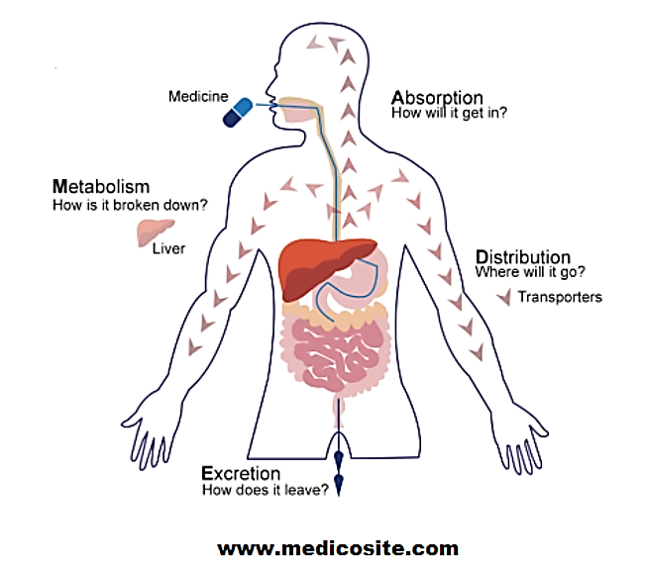
ADME properties
How much
How fast
How fast
Mechanism
Metabolites
Where to
How fast
How much
Which route
How fast
https://www.medicosite.com

Slide 22
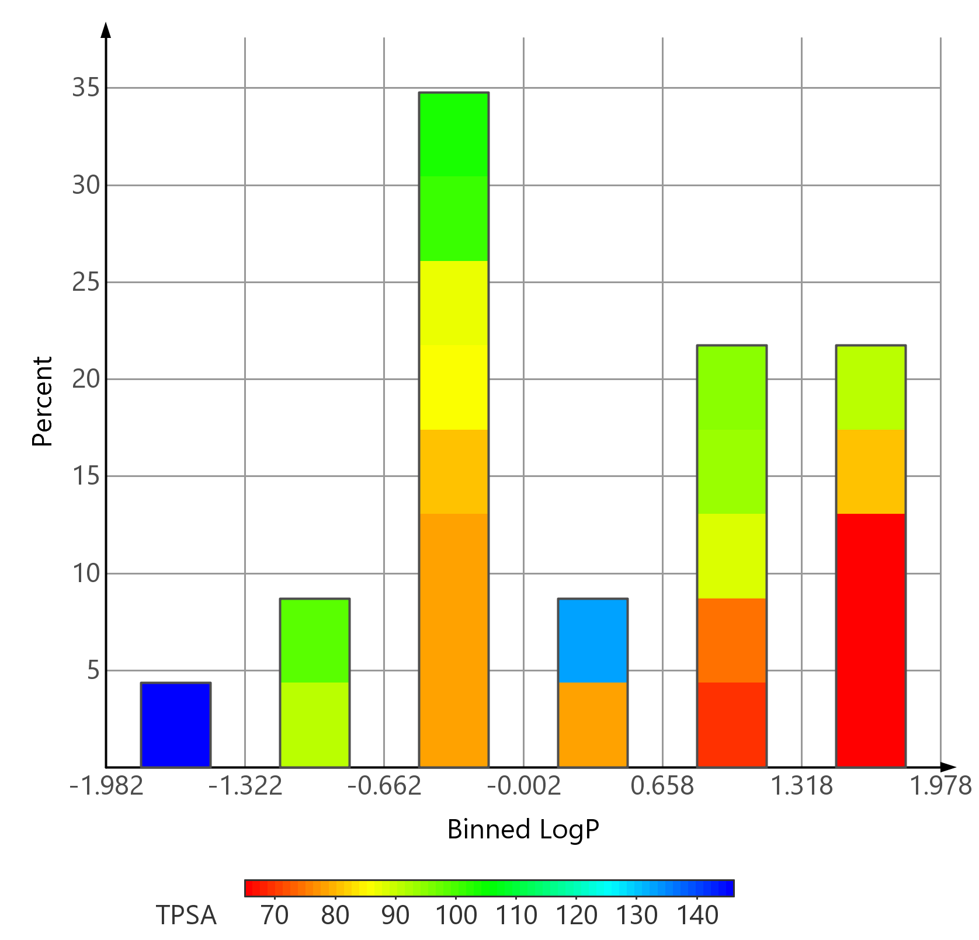
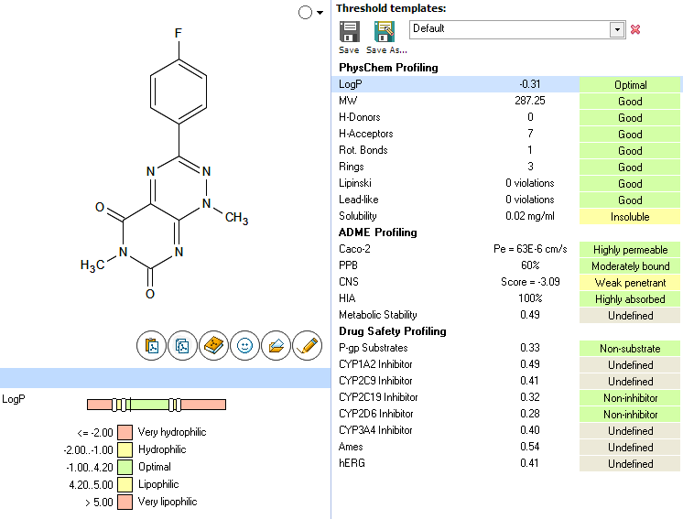
In silico profiling of physico-chemical properties

Slide 23
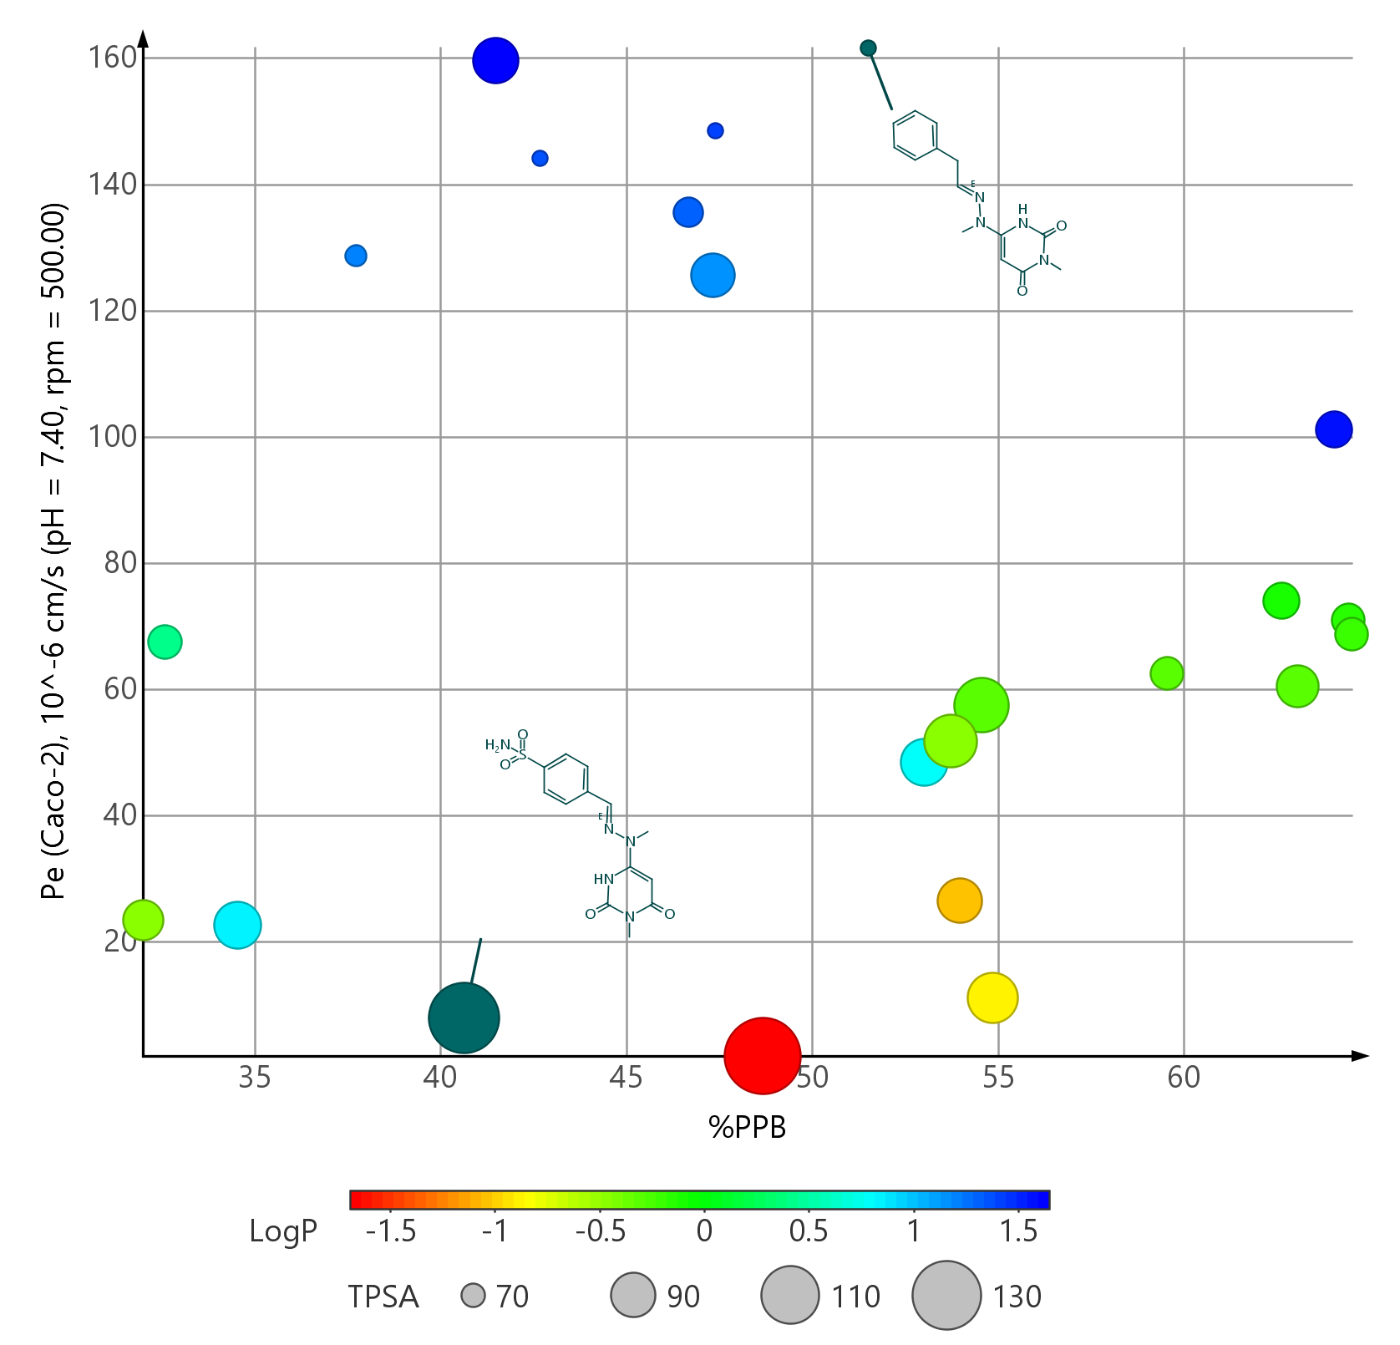
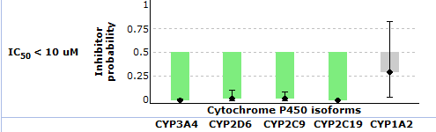
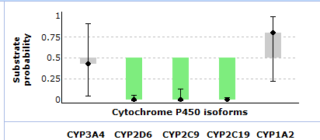
In silico profiling of ADME properties
Permeability and plasma protein binding
CYP interactions

Slide 24
From design to profiling
Design of focused toxoflavine library
  Ligand-receptor interactions
  In silico ADME profiling
Synthesis of focused library
Biological profiling – binding studies
In vitro ADME profiling
Biological profiling – cell-based assays

Slide 25
Inhibitor synthesis
General synthetic route

Slide 26
From design to profiling
Design of focused toxoflavine library
  Ligand-receptor interactions
  In silico ADME profiling
Synthesis of focused library
Biological profiling – binding studies
In vitro ADME profiling
Biological profiling – cell-based assays

Slide 27
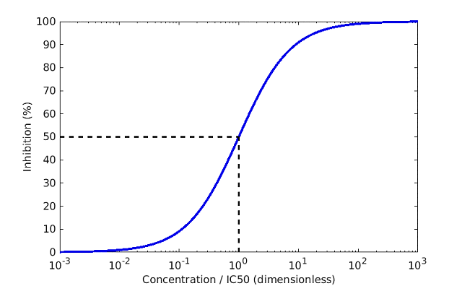
Biological activity profiling
To determine inhibitor activity:
  Percentage of inhibition at 10μM
  Obtain IC₅₀ values for best compounds
Biochemical assay
  Commercal JMJD2C chemiluminescence immunoassay
  Highly specific antibody that recognizes demethylated substrate
  Incubation: 37°C, 60 min
  HRP (horseradish peroxidase) -labeled antibody
  STOP buffer and chemiluminescence readout

Slide 28
Activity profiling
Linear compounds
70-100%
% of inhibition at 10 µM
40-70%
0-40%

Slide 29
Activity profiling
Cyclic compounds
% of inhibition at 10 µM
100%
All compounds show 100% inhibition
at 10 µM concetration
To determine IC₅₀ values

Slide 30
From design to profiling
Design of focused toxoflavine library
  Ligand-receptor interactions
  In silico ADME profiling
Synthesis of focused library
Biological profiling – binding studies
In vitro ADME profiling
Biological profiling – cell-based assays

Slide 31
In vitro ADME profiling
Cyclic compounds
100%
All compounds are highly permeable and stable in mouse microsomes
µM IC₅₀ on HepG2 cell line – need to de-convolute JMJD2C activity from non-specific influence on cell viability

Slide 32
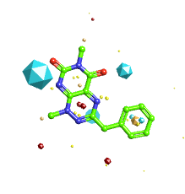
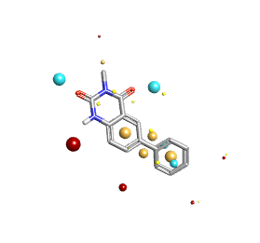
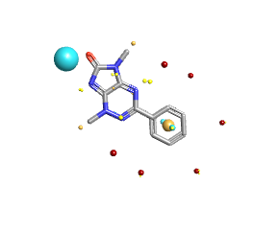
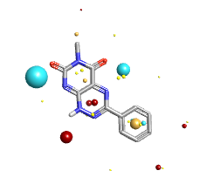
Scaffold hopping exercize
All compounds are highly permeable and stable in mouse microsomes
No influence on cell viability on HepG2 and A549 cell lines
But.. Loss of potency

Slide 33
From design to profiling
Design of focused toxoflavine library
  Ligand-receptor interactions
  In silico ADME profiling
Synthesis of focused library
Biological profiling – binding studies
In vitro ADME profiling
Biological profiling – cell-based assays
  HepG2 cell line – 24h
  A549 cell line – 72h

Slide 34
Summary of activity and ADME results
Cpd | JMJD2C IC₅₀ [nM] | Passive permeability(A2B) Papp [x10-6 cm/sec] | P-gp substrate | Clint [µl/min/mg] | HepG2 IC₅₀ [uM] 1 day | A549 IC₅₀ [µM] 3 days
4a | 130 | 34.7 | - | <12.5 | 0.87 | 1.1
4b | 11 | 26.8 | - | <12.5 | 0.80 | 1.9
4c | 242 | 13.2 | - | <12.5 | 1.1 | 5.8
4d | 8 | 34.5 | - | <12.5 | 0.80 | 1.1
4e | 42 | 0.8 | - | <12.5 | 5.6 | >30
4f | - | 24.9 | + | <12.5 | 1.2 | 1.3
4g | 29 | 25.3 | - | <12.5 | 5.1 | >30
4j | 19 | 13.4 | - | 11.6 | 1.8 | 4.3
4k | - | 1.1 | - | 71850 | 4.5 | 8.8
4l | 16 | 18.0 | - | <12.5 | 2.1 | 5.7
4m | 81 | 30.6 | - | <12.5 | 0.82 | 1.6
5a | >10000 | 27.3 | - | 229.1 | >25 | >30
5b | 7626 | 35.5 | - | <12.5 | >25 | >30
5c | 12650 | 40.6 | - | 13.1 | >25 | >30
Toxoflavin | 541 | 16.0 | - | <12.5 | 4.5 | 0.022

Slide 35
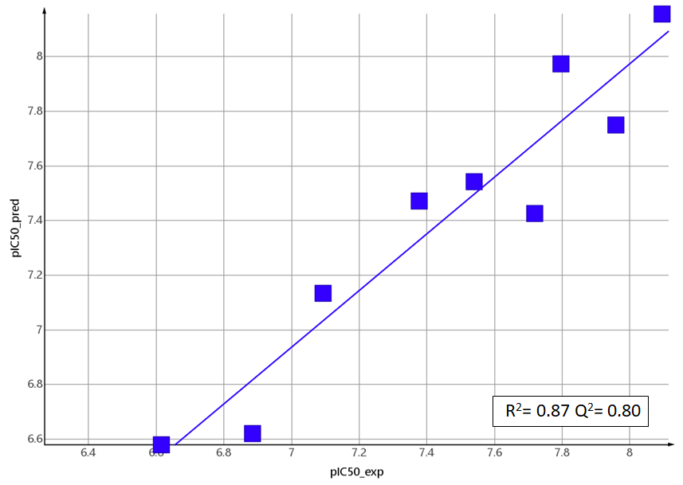
Building a prediction model
Linear combination of QM/MM interaction energies and desolvation-characterizing changes in the solvent-accessible surface areas (SASA)
Conformational changes of the ligands upon binding are assumed to be small due to the rigidity of the compounds
Desolvation contribution approximated by different descriptors describing ligand solvent-accessible surface areas, Δ(SASA): FOSA, FISA, PISA, HBA, HBD, dipole, volume and globularity
Experimental activities expressed as pIC₅₀ values were correlated, with QM/MM energies and QikProp descriptors described above, using PLS (partial-least square method)
Descriptor | Qsite_SP
Eint | -0.78
Dipole | -0.91
FOSA | 0.79
∆G_{b}=α×Δ〈E_{vdW} 〉 + β×Δ〈E_{el} 〉 + γ×Δ〈SASA〉 + κ
Correlation between experimental and predicted pIC50 values for a set of JMJD2C inhibitors based on toxoflavin scaffold

Slide 36
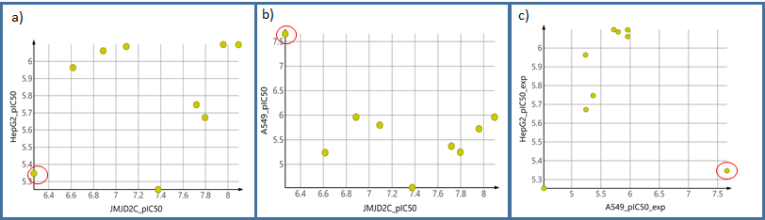
Inhibitor activity vs. cell viability
Toxoflavine
Inhibitory JMJD2C enzyme activity vs. influence on the cell proliferation for a) HepG2 and b) A549 cell-lines
Significant difference in IC₅₀ values for toxoflavine of two different cell lines is an indication that non-specific toxicity of toxoflavin due to its redox potential is reduced for the investigated toxoflavin derivatives

Slide 37
Conclusions
Detailed analysis of available structural and biological data
A range of non-carboxylate inhibitors of the JMJD2C histone lysine demethylase based on toxoflavin scaffold was designed and synthesized
Activity improvement - a number of compounds possess promising nM range activity in target-specific, biochemical assay against JMJD2C
Favourable ADME -inhibitors displayed good passive cellular permeability and metabolic stability
Partial decrease of redox liabilities - redox liability and consequently non-specific influence on cell viability still remains a challenge
Good starting point for further optimization
  wider structural diversification of R substituents
  explore further scaffold hopping options
  keep favourable ADME proporties

Slide 38

Contributions
Dubravko Jelić, PhD – Biology
Adriana Petrinić Grba, MSc – Biology
Ana Bokulić, MSc – DMPK
Sanja Koštrun, PhD - CADD

