Slide 1

Conformational analysis of fused ring systems using tensor decomposition methods
Karlo Sović
Department of Chemistry
Faculty of Science
University of Zagreb

Slide 2
Contents
Introduction
Tensor decomposition tools & probability distribution function
Procedure
Results and discussion
Conclusion

Slide 3
Introduction
Problem: Investigation (exploration) of potential energy surface of molecule of interest in ground state with or without the presence of variable external potential.
Method of our choice: Multi-way analysis of ab-initio molecular dynamics trajectories at several different temperatures.

Slide 4
Introduction
Other methods that can be used:
Sistematic (grid) search
Monte Carlo (MC) or stochastic methods
Metadynamics (MTD)
Steered molecular dynamics (SMD)

Slide 5
Introduction
Motivation:
During molecular dynamics run, we assume that the molecule will spend statistically more time in vicinity of local minima on PES.
In order to overcome high potential barriers and thoroughly scan PES we use several different temperatures.
Tensor decomposition tools must be used to reduce the dimensionallity of the problem.

Slide 6

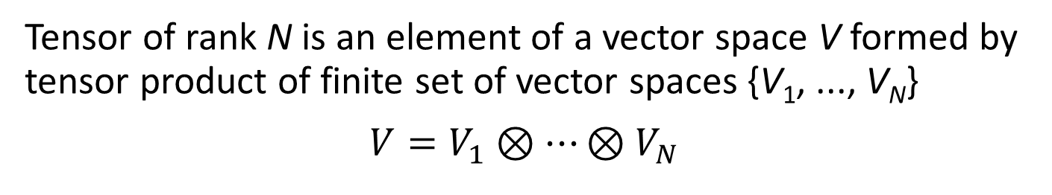

Tensor decomposition tools
Tensor of rank N is an element of a vector space V formed by tensor product of finite set of vector spaces {V₁, ..., V_{N}}
$$V=V_{1}⊗⋯⊗V_{N}$$
I
I
I
K
I
J
K
L
J
J
a
A
$$𝒜$$
$$𝒜$$
Vector
Matrix
(2nd-order tensor)
3rd-order tensor
4th-order tensor
{a_{i}}
{A_{ij}}
{A_{ijk}}
{A_{ijkl}}

Slide 7

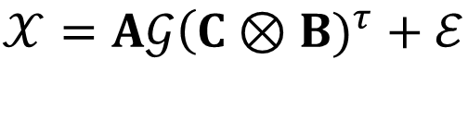

Tensor decomposition tools
w₃
C
K
B
w₂
w₂
$$𝒢$$
w₃
J
𝒳
A
w₁
$$ℰ$$
I
I
I
K
K
J
w₁
J
Tucker3 model:
$$𝒳=A𝒢\left(C\right.⊗B)^{τ}+ℰ$$
Tucker decomposition approximates tensor by projecting it onto high-variance subspaces to reduce dimensionallity.

Slide 8
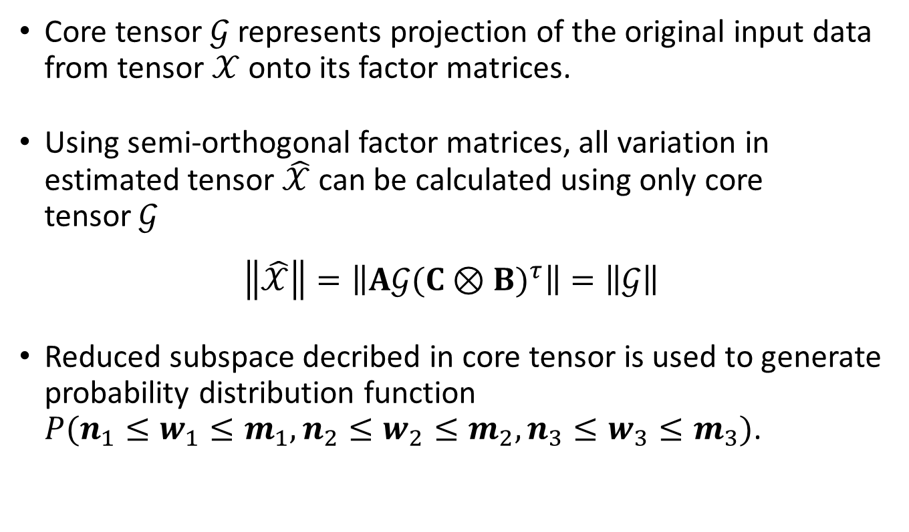
Probability distribution function
Core tensor $𝒢$ represents projection of the original input data from tensor $𝒳$ onto its factor matrices.
Using semi-orthogonal factor matrices, all variation in estimated tensor $\hat{𝒳}$ can be calculated using only core tensor$𝒢$
$$\left\|\hat{𝒳}\right\|=\left\|A𝒢(C⊗B)^{τ}\right\|=\left\|𝒢\right\|$$
Reduced subspace decribed in core tensor is used to generate probability distribution function
$P(n_{1}≤w_{1}≤m_{1},n_{2}≤w_{2}≤m_{2},n_{3}≤w_{3}≤m_{3})$.

Slide 9
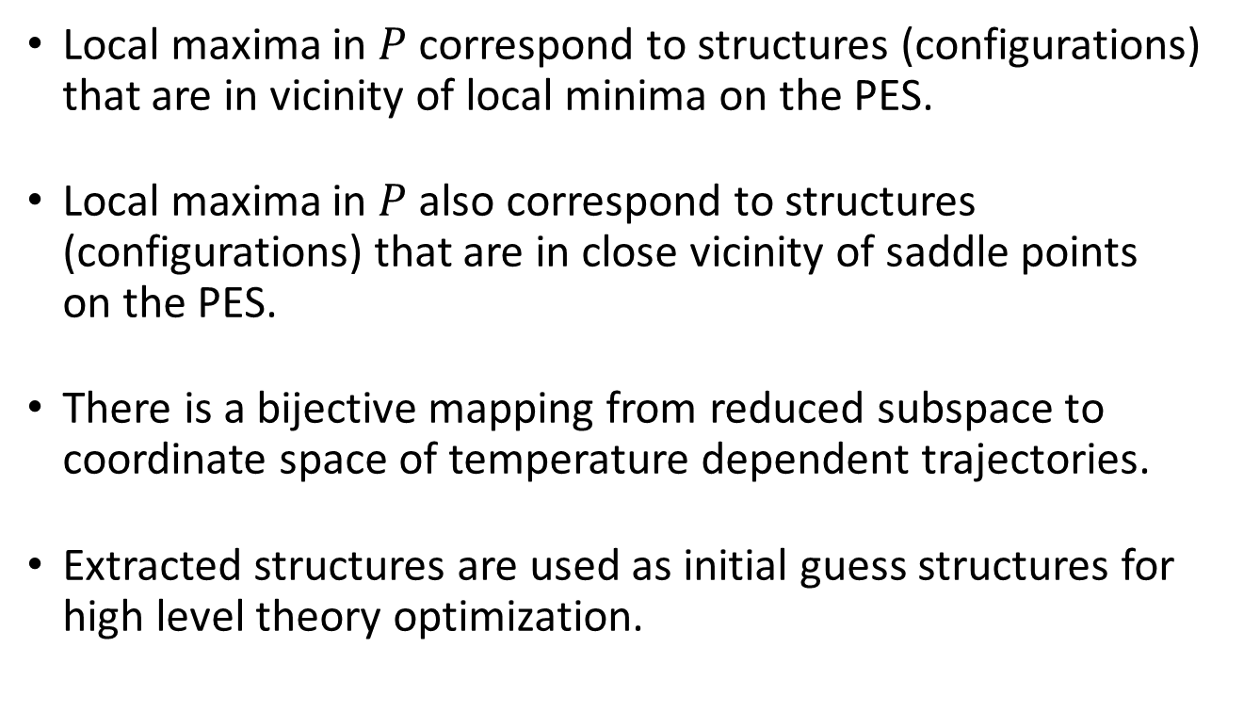
Probability distribution function
Local maxima in $P$ correspond to structures (configurations) that are in vicinity of local minima on the PES.
Local maxima in $P$ also correspond to structures (configurations) that are in close vicinity of saddle points
on the PES.
There is a bijective mapping from reduced subspace to coordinate space of temperature dependent trajectories.
Extracted structures are used as initial guess structures for high level theory optimization.

Slide 10
Procedure
Definition of variable external potential (optional).
Calculation of trajectories for different temperatures.
Multi-way analysis using Tucker3 model with TUCKALS3 algorithm.
Calculation of probability distribution function.
Optimization on higher level of theory.
Clustering and vibrational analysis.

Slide 11
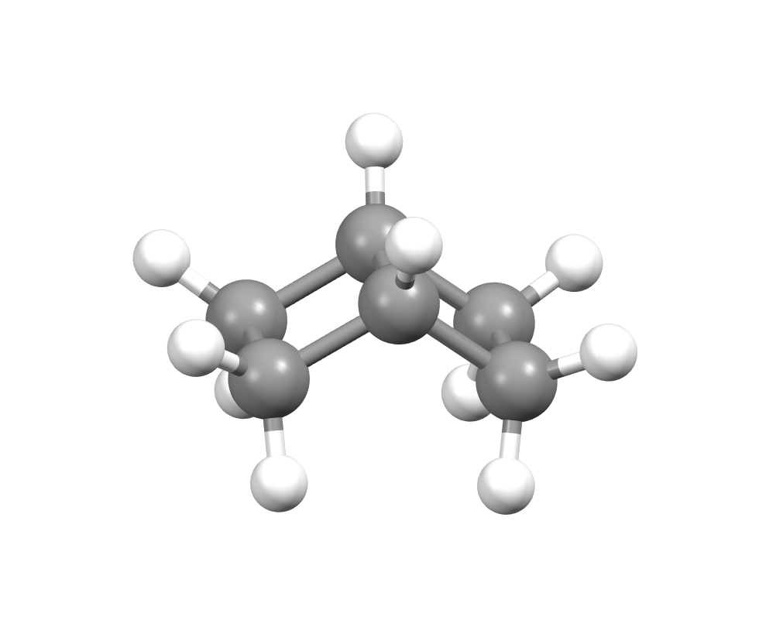
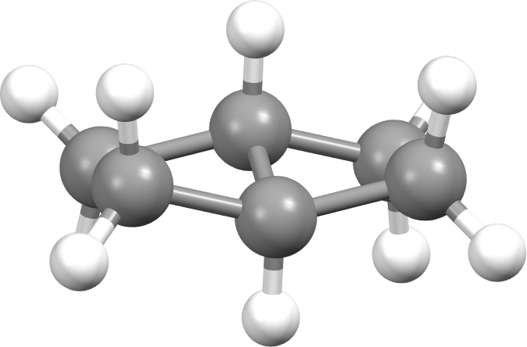
Results
System: Bicyclo[2.2.0]hexane in vacuo
Figure 1. Conformer of cis-bicyclo[2.2.0]hexane*
Figure 2. Conformer of trans-bicyclo[2.2.0]hexane*
* Structures were optimized using B3LYP-D3/6-311++G(d,p)

Slide 12
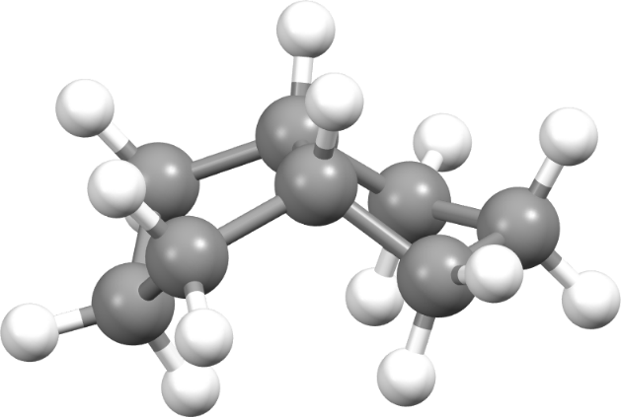
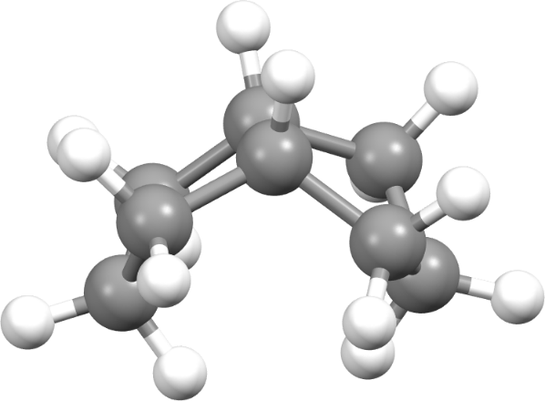
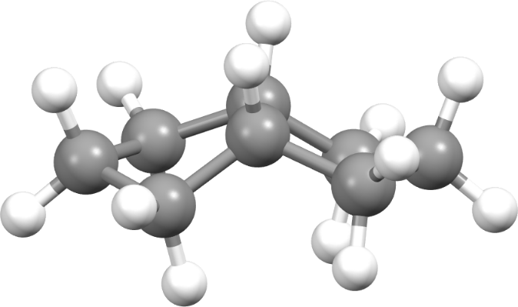
Results
System: Bicyclo[3.3.0]octane in vacuo
1
2
3
Figure 3. Conformers of cis-bicyclo[3.3.0]octane*
* Structures were optimized using B3LYP-D3/6-311++G(d,p)

Slide 13
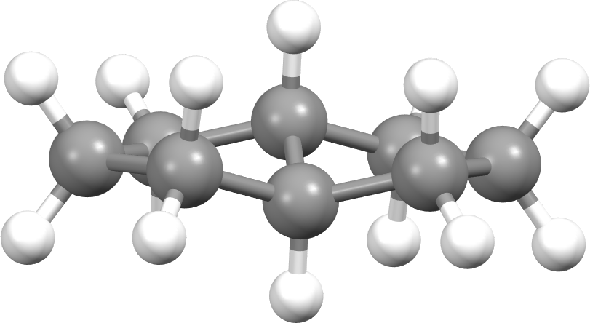
Results
System: Bicyclo[3.3.0]octane in vacuo
Figure 4. Conformer of trans-bicyclo[3.3.0]octane*
* Structure was optimized using B3LYP-D3/6-311++G(d,p)

Slide 14
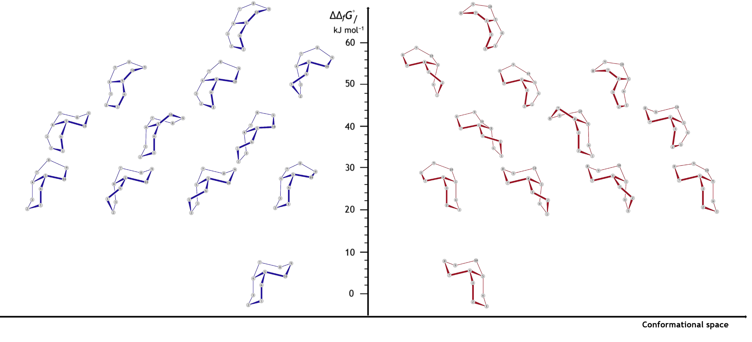
Results
System: Bicyclo[4.4.0]decane in vacuo
Figure 5. Conformers of cis-bicyclo[4.4.0]decane

Slide 15
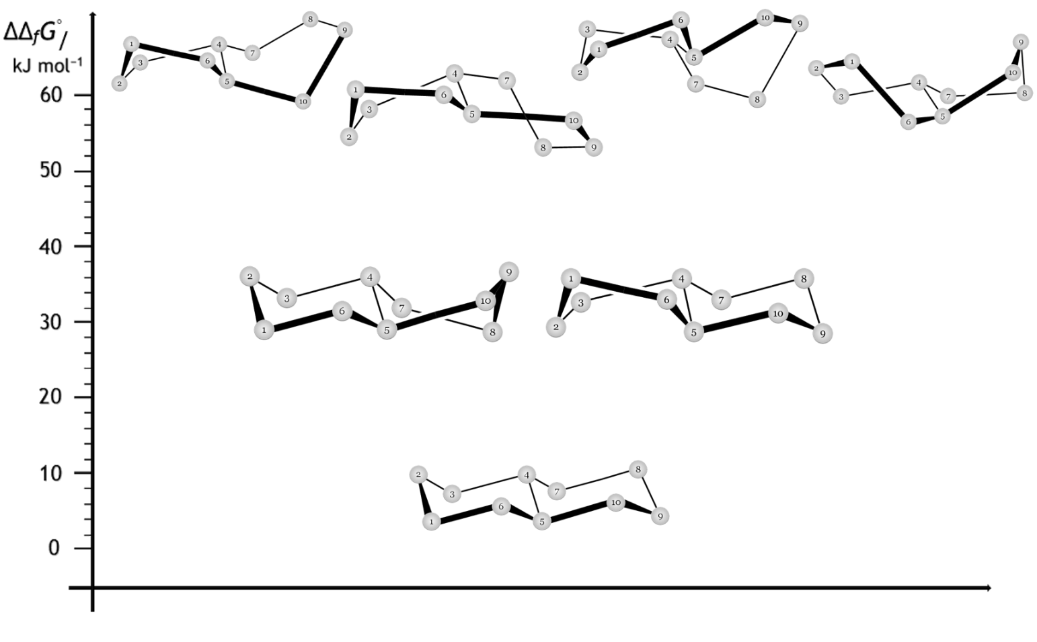
Results
System: Bicyclo[4.4.0]decane in vacuo
Figure 6. Conformers of trans-bicyclo[4.4.0]decane

Slide 16
Conclusion
Conformational space of bicyclo[2.2.0]hexane(1), bicyclo[3.3.0]octane(2) and bicyclo[4.4.0]decane(3) was investigated by performing multi-way analysis on temperature dependent trajectories.
For system (1), there was only 1 conformer found for each isomer.
For system (2), 3 confomers were found for cis- and only 1 conformer for trans- isomer.
For system (3), 12 conformers were found for each enantiomer of cis- isomer and 7 conformers for each enantiomer of trans- isomer.

Slide 17
Conclusion
Full conformational space can be obtained independently of the size or structure of the molecule (or system).
Additional chemical information can be extracted from 2nd or 3rd way loadings.

Slide 18
Thank you for your attention!

Slide 19
BONUS:

Slide 20



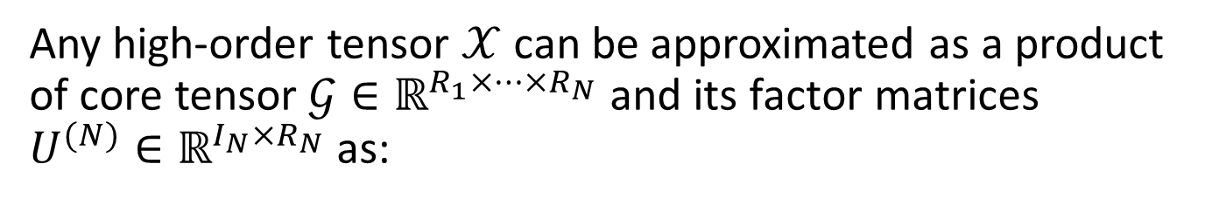


Tensor decomposition tools
Any high-order tensor $𝒳$ can be approximated as a product of core tensor $𝒢∈ℝ^{R_{1}×⋯×R_{N}}$ and its factor matrices $U^{(N)}∈ℝ^{I_{N}×R_{N}}$ as:
$$𝒳≈𝒢×_{1}U^{(1)}×_{2}U^{(2)}×_{3}⋯×_{N}U^{\left(N\right)}$$
w₂
$$𝒢$$
$$×$$
$$×$$
$$×$$
1
U⁽¹⁾
2
U⁽²⁾
3
U⁽³⁾
𝒳
w₃
I
w₁
I
J
K
K
J
w₁
w₂
w₃

