Slide 1
Development of new zinc ion parameters suitable for classical MD simulations of zinc metallo-peptidases
Dr. sc. Antonija Tomić, Institut ruđer bošković
May 11th 2019, zagreb

Slide 2
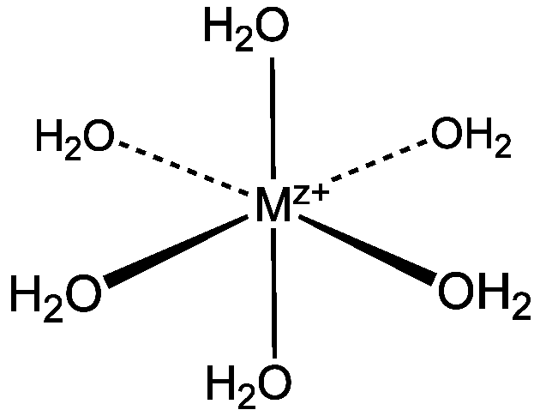
INTRODUCTION
1/3 of all proteins contain metal ions - a catalytic role or a structural role
Zn²⁺ in aqueous solution – octahedral coordination
Analysis of the protein X-ray structures with zinc site:*
*Patel, K.; Kumar, A.; Durani, S. Biochim. Biophys. Acta - Proteins Proteomics 2007, 1774 (10), 1247–1253.

Slide 3
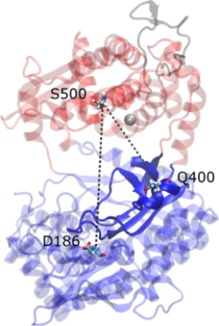
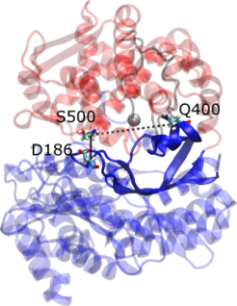

Human dipeptidyl peptidase III (DPP III)
Upper domain
Zinc-metallopeptidase
peptide bond hydrolysis
Implied role in the:
intracellular protein catabolism
pain modulation
defense against oxidative stress
...
In vitro: broad substrate specificity
Lower domain
zatvorena
[cWT]
otvorena
[oWT]
open DPP III
(oDPP III)
closed DPP III
(cDPP III)

Slide 4
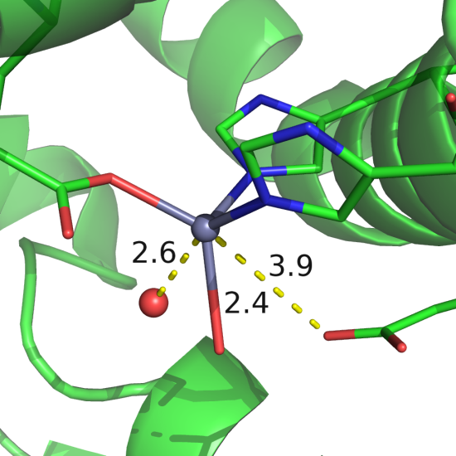

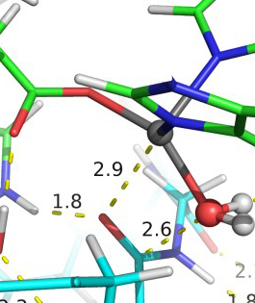
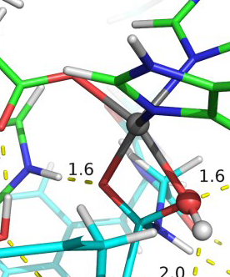
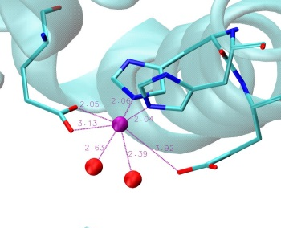
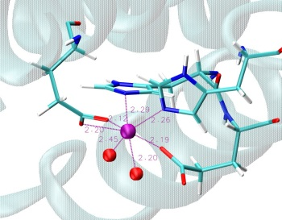
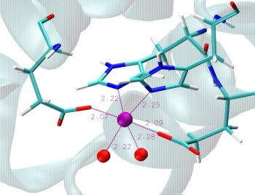
QMMM calculations*
H⁴⁵⁰EXXGH⁴⁵⁵
E⁵⁰⁷E⁵⁰⁸CXXE⁵¹²
DPP III - Leu-enkephalin
CB=4
CB=5
E451
pdb: 3FVY
ES
INT1
<d> / Å
NONBONDING parameters
q= +2.0 e, R_{min}= 1.22 Å, ε_{min}= 0.250 kcal mol⁻¹
H450
E508
H455
3 min. cycles
101 ns MD sim.
E451
pdb: 3FVY
*A. Tomić, B. Kovačević, S. Tomić Phys. Chem. Chem. Phys. 18 (2016) 39.

Slide 5
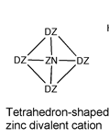
CATIONIC DUMMY ATOM (CaDA) MODEL
Yuan-Ping Pang 2005* - Amber all-atom force field parameters for the CaDA approach using an explicit solvent model
bond |  |  |  | K [ kcal/(mol Å²)] |  | Req (Å)
DZ-ZN |  |  |  | 640 |  | 0.90
DZ-DZ |  |  |  | 640 |  | 1.470
angle |  |  |  | K [kcal/(mol radian²)] |  | Teq (deg.)
DZ-ZN-DZ |  |  |  | 55 |  | 109.50
DZ-DZ-DZ |  |  |  | 55 |  | 60.0
DZ-DZ-ZN |  |  |  | 55 |  | 35.25
dihedral |  |  |  |  | IDIVF | Vn/2 (kcal/mol) | γ(deg.) | N
ZN-DZ-DZ-DZ |  |  |  |  | 1 | 0 | 35.3 | 2
DZ-ZN-DZ-DZ |  |  |  |  | 1 | 0 | 120.0 | 2
DZ-DZ-DZ-DZ |  |  |  |  | 1 | 0 | 70.5 | 2
VDW | mass | r*(Å) | Eps (kcal/mol) |  | VDW | mass | r*(Å) | Eps (kcal/mol)
ZN | 53.38 | 3.1 | 1E-6 |  | DZ | 3.0 | 0 | 0
+0.5
+0.5
+0.5
+0.5
Tetrahedron-shaped zinc divalent cation
* http://www.mayo.edu/research/labs/computer-aided-molecular-design/projects/zinc-protein-simulations-using-cationic-dummy-atom-cada-approach

Slide 6
40 ns, NpT, ff14sb, TIP3P, AMBER 16
system | <CN> ± SD
cDPP III (5EGY) | 4.67 ± 0.70
cDPP III – L-en (QMMM) | 5.13 ± 0.66
L-en = Leu-enkephalin

Slide 7
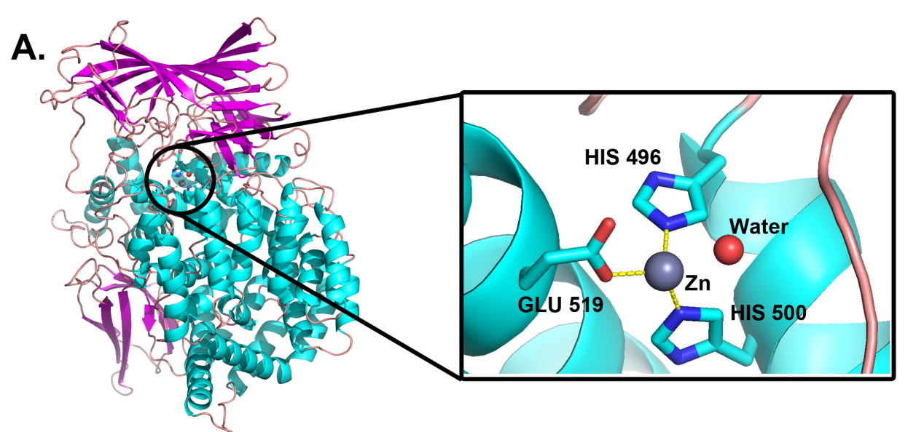
HYBRID BONDING/NONBONDING MODEL
W. Yang et al. Generation of AMBER force field parameters for zinc centres of M1 and M17 family aminopeptidases, Journal of Biomolecular Structure and Dynamics (2017) DOI: 10.1080/07391102.2017.1364669
M1 aminopeptidase from Plasmodium falciparum

Slide 8
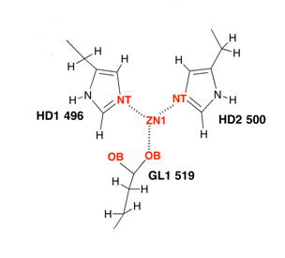
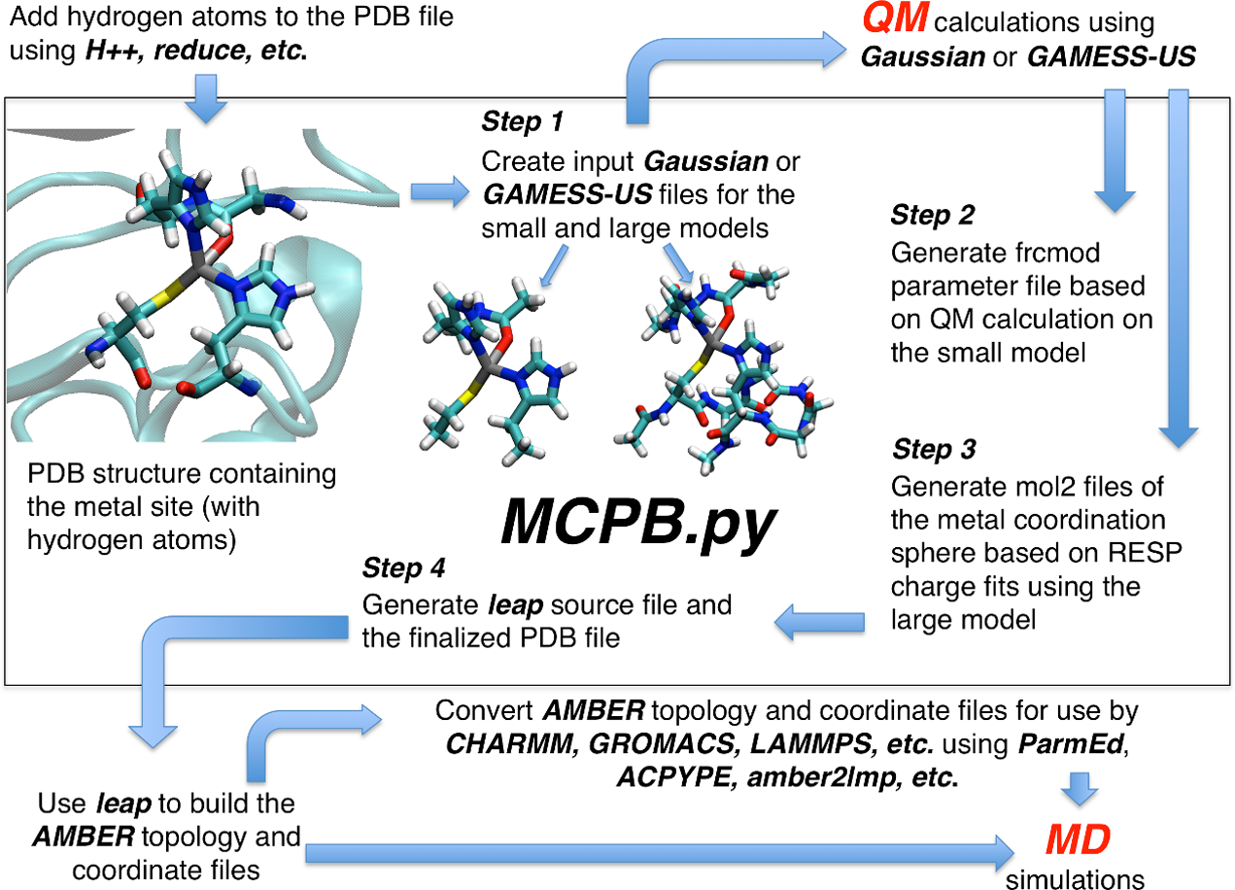
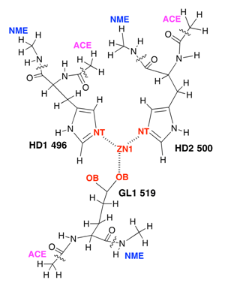
P. Li and K. M. Merz, MCPB.py: A Python Based Metal Center Parameter Builder J. Chem. Inf. Model. 56 (2016) 599−604.
CH₃
CH₃
BONDING PARAM.
CH₃
M1 aminopeptidase
NONBONDING PARAM.

Slide 9
M1 aminopeptidase parameters
40 ns, NpT, ff14sb, TIP3P, AMBER 16
system | <CN> ± SD
cDPP III (3T6B) | 5.32 ± 0.47
cDPP III (5EGY) | 5.01 ± 0.07
cDPP III – L-en (3T6B) | 5.00 ± 0.00
cDPP III – L-en (5E3A) | 5.00 ± 0.00
L-en = Leu-enkephalin

Slide 10
4-ligand-extended model
100 ns, NpT, ff14sb, TIP3P, AMBER 16
system | <CN> ± SD
oDPP III (3FVY, 220 ns) | 4.86 ± 0.35
cDPP III (5EGY) | 4.91 ± 0.29
cDPP III – L-en (QMMM) | 4.28 ± 0.45
cDPP III – L-en (5E3A) | 4.01 ± 0.11
cDPP III – RRNA₁ (3T6B) | 4.59 ± 0.50
cDPP III – RRNA₂ (3T6B) | 4.55 ± 0.51
L-en = Leu-enkephalin
RRNA = Arg-Arg-2-naphthylamide

Slide 11
4-ligand-extended model
100 ns, NpT, ff14sb, TIP3P, AMBER 16
L-en = Leu-enkephalin
RRNA = Arg-Arg-2-naphthylamide

Slide 12
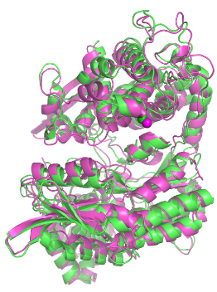
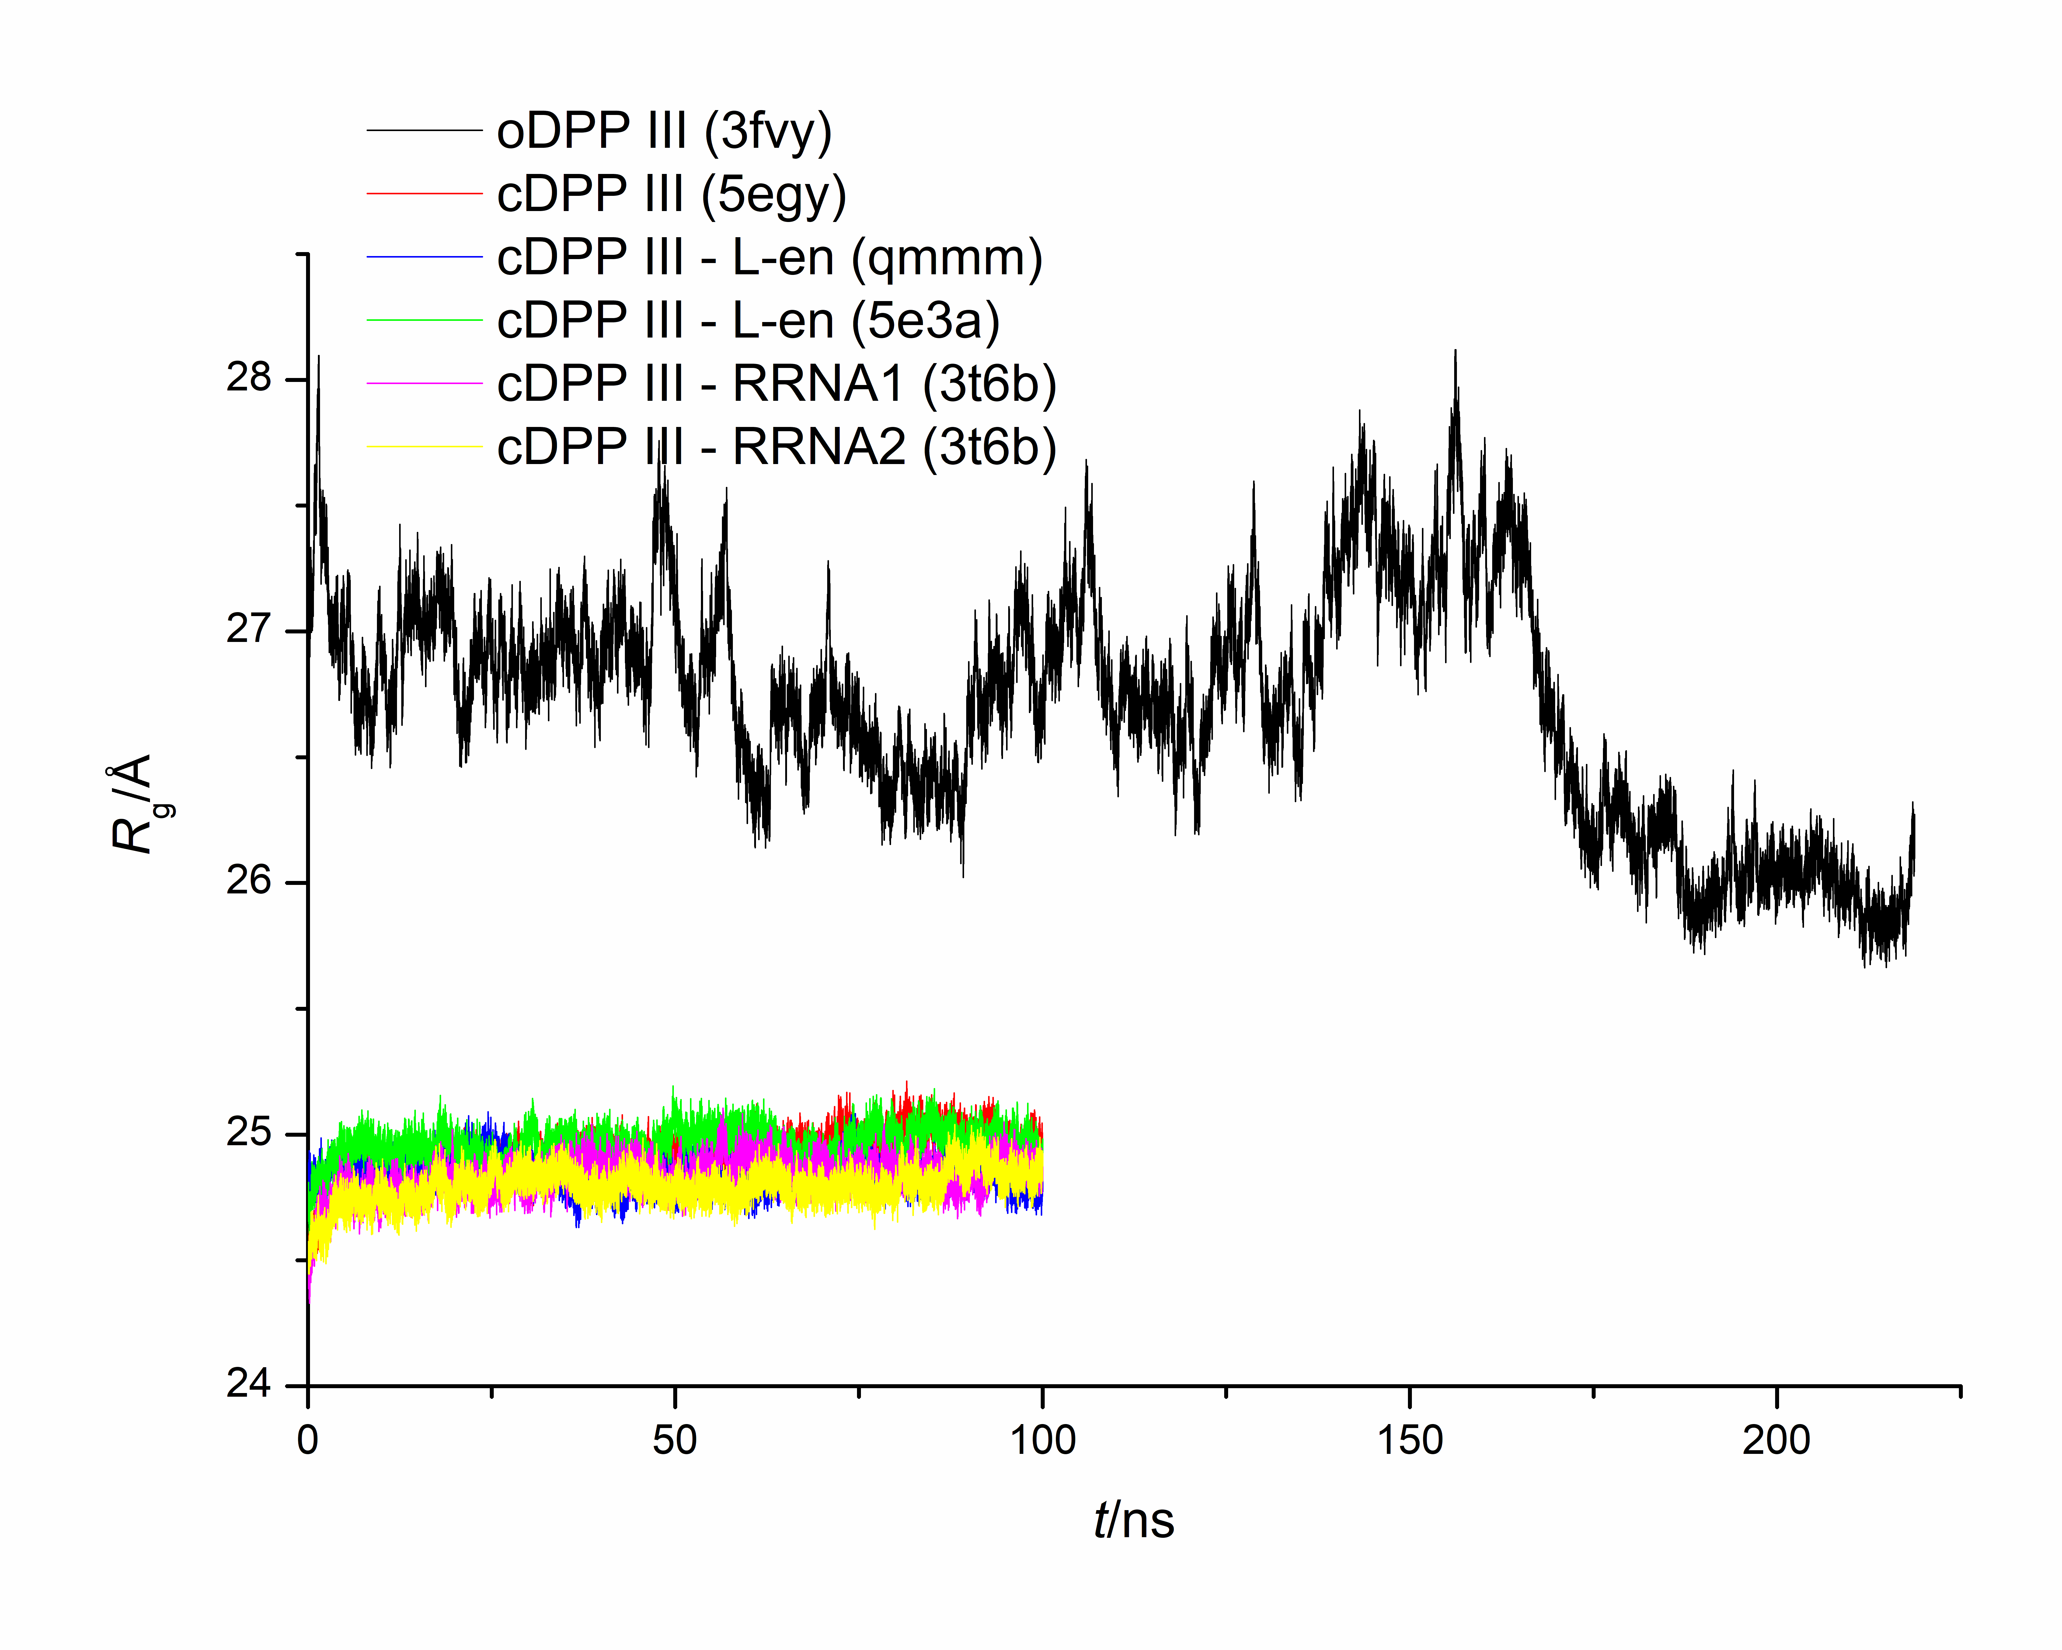
EFFect on protein dynamics?
Nonbonding param.* (R_{g,min}=25.34 Å)
Hybrid bonding/nonbonding param. (R_{g,min}=25.66 Å)
oDPP III – 1
oDPP III – 2
oDPP III – 3
cDPP III – 1
cDPP III – 2
cDPP III – 3
cDPP III – 4
oDPP III – gromacs
L-en = Leu-enkephalin
RRNA = Arg-Arg-2-naphthylamide
*A. Tomić, M. Berynskyy, R. C. Wade, S. Tomić, Mol. BioSyst. 11 (2015) 3068—3080.

Slide 13
EFFECT ON LIGAND BINDING AFFINITIES?
MM-PBSA calculations
Nonbonding param.*
Hybrid bonding/nonbonding param.
cDPP III – Leu-enkephalin (QMMM)
cDPP III – Leu-enkephalin (5E3A)
cDPP III – Arg-Arg-2-naphthylamide - 1 (3T6B)
cDPP III – Arg-Arg-2-naphthylamide - 2 (3T6B)
*A. Tomić, S. Tomić, Dalt. Trans. 43 (2014) 15503–15514.

Slide 14
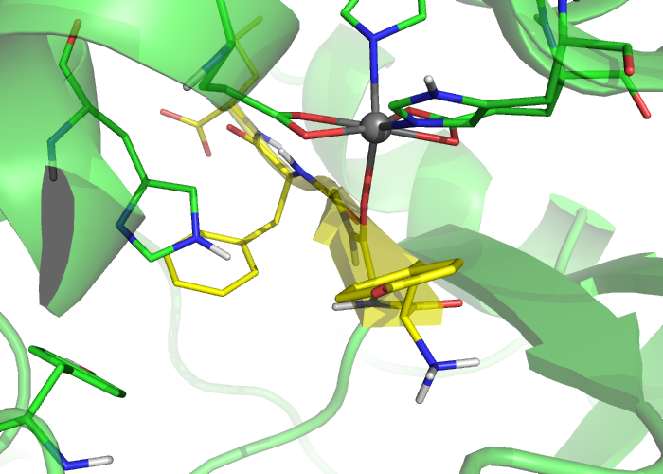
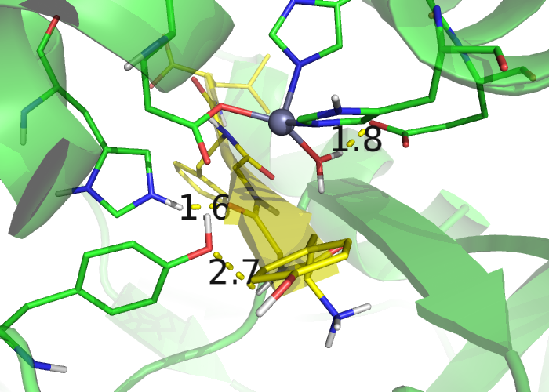
cDPP III – Leu-enkefalin complex
E451
E451
H568
H568
Y318
Y318
Nonbonding parameters
Hybrid bonding/nonbonding parameters
NONREACTIVE BINDING MODE
REACTIVE BINDING MODE

Slide 15

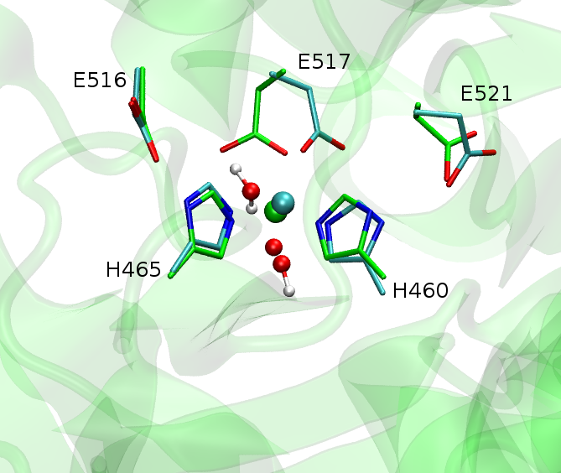
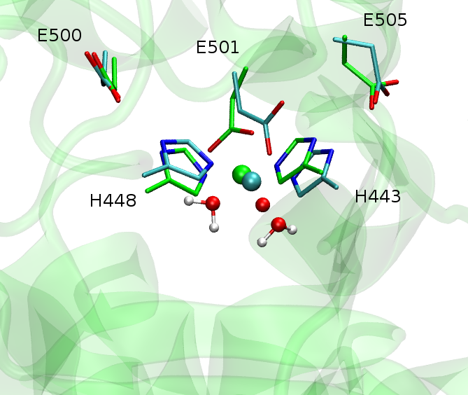
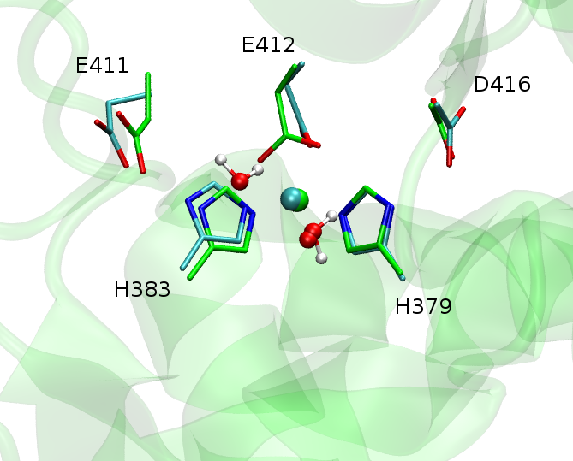
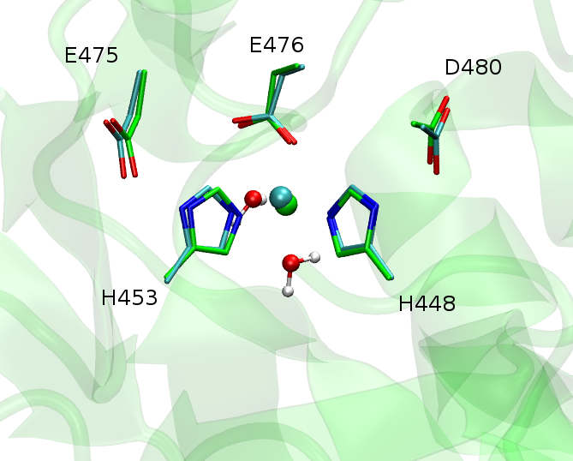
MD simulations of zinc metallo-peptidases
dr. sc. Hrvoje Brkić & dr. sc. Dejan Agić
Yeast
Armillaria tabescens
Thermolysin
Neprilysin
Bacteroides thetaiotaomicron
Caldithrix abyssi
Aminopeptidase N
X-ray structure & structure after 150 ns of MD simulation

Slide 16
ACKNOWLEDGMENT
prof. dr. sc. Sanja Tomić, IRB, Zagreb
prof. dr. sc. Michael Ramek, TU Graz, Austria
  dr. sc. Dejan Agić & dr. sc. Hrvoje Brkić, Josip Juraj Strossmayer University of Osijek
THANK YOU FOR YOUR ATTENTION!

